Slide 1

Progression of ADAS safety systems…now and into the Future
Emerging Technologies Committee (Digital)
Co-Chairs:
Chuck Olsen – AirPro Diagnostics
Bob Augustine – Opus IVS
Notes:
Chuck Olsen: Introduce session, Thank all committee members

Slide 2

Agenda
Advanced Driver Assistance Systems (ADAS) Refresher
ADAS Market Sizing
Developing Technology - ADAS & Calibration
SEMA’s Modified Vehicle ADAS Research
NHTSA Update (Automatic Emergency Braking)
Q&A - Panel Discussion
Notes:
Chuck Olsen

Slide 3
Progression of ADAS safety systems…now and into the Future
Presenters/Panelists:
Mike Muller (SEMA Garage) ADAS 101 and Modified Vehicle Research
Nick Dominato (I-CAR) ADAS Market Sizing and New Technologies
Greg Peeters (Car ADAS) New ADAS and Calibration Technologies
Chuck Olsen (AirPro) New ADAS and Calibration Technologies
Notes:
Introduce Presenters/panelists
Mike Muller, ADAS Engineer, SEMA Garage Detroit,
Previously worked at Bosch in automotive technology start-ups for Electrification, Connected Cloud Services & ADAS.
Nick Dominato, Director of Product management , I-Car, Previously founded adasThink. Automatic ADAS calibration identification for body shops.
Greg Peeters, Chief Executive Officer - Car ADAS Solutions LLC, Previously Director of Field operations with Astech, Vice President, ABRA/ ACES Technician Apprentice Program

Slide 4
ADAS 101 Refresher
Presented by: Mike Muller
ADAS Engineer, SEMA Garage Detroit
Notes:
Mike Muller

Slide 5

ADAS 101
What vehicle components make-up ADAS?
Notes:
Mike Muller

Slide 6
ADAS 101
What vehicle components make-up ADAS?
      Radars
      Cameras
      Lidar
      Ultrasonics
Notes:
Mike Muller

Slide 7
ADAS 101
What vehicle components make-up ADAS?
      Radars GPS
      Cameras Human Machine Interfaces (Displays)
      Lidar Alarms
      Ultrasonics Seat Haptics
Notes:
Mike Muller

Slide 8
ADAS 101
What vehicle components make-up ADAS?
      Radars GPS Braking (software)
      Cameras HMI-Display Steering (software)
      Lidar Alarms Alerts (mirror, etc.)
      Ultrasonics Seat Haptics Adaptive Headlights
      Night Vision Heads-up Display
      Etc. Etc. Etc….
Notes:
Mike Muller

Slide 9
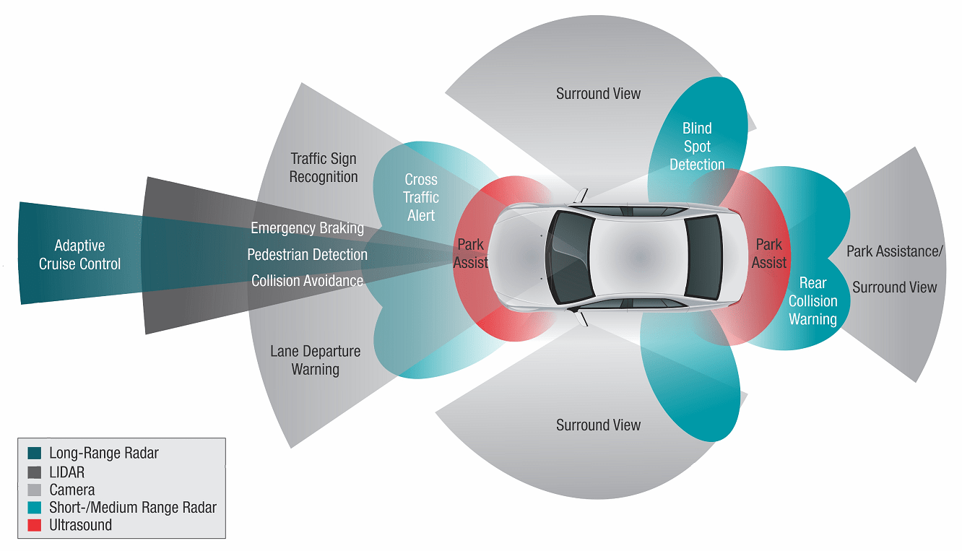
ADAS 101
What are ADAS Features?
Notes:
Mike Muller

Slide 10
ADAS 101
What are ADAS Features?
    Lane Departure Warning (LDW)
    Lane Keep Support (LKS)
    Crash Imminent Braking (CIB)=(AEB)
    Traffic Jam Assist (TJA)
    Blind Spot Detection (BSD)
    Rear Cross Traffic Alert (RCTA)
    Pedestrian Automatic Emergency Braking (PAEB)

Slide 11
ADAS Market Sizing
Presented by:
Nick Dominato
Director of Product Management, I-CAR
Notes:
Nick Dominato

Slide 12
ADAS Adoption is Growing Rapidly
Vehicles with a Forward-Facing Camera, by model year
Notes:
Nick Dominato

Slide 13
…But Still Hasn’t Penetrated Most of the Car Parc
Vehicles with a Forward-Facing Camera, by model year
Today, 26% of vehicles on the road have a forward-facing camera
70% of vehicles are 6 years old, or older – vehicles with low ADAS adoption
71%
Notes:
Nick Dominato

Slide 14
ADAS Penetration in 2026
Vehicles with a Forward-Facing Camera, by model year
In 2026, 41% of vehicles have a forward-facing camera
70% of vehicles are 6 years old, or older – vehicles with medium ADAS adoption
71%
29%
Notes:
Nick Dominato

Slide 15
ADAS Penetration in 2030
Vehicles with a Forward-Facing Camera, by model year
In 2030, 60% of vehicles will have forward-facing camera
70% of vehicles are 6 years old, or older – vehicles with high ADAS adoption
71%
29%
Notes:
Nick Dominato

Slide 16
15% Compound Annual Growth Rate
The ADAS Calibration Market….Big & Getting Bigger:
Auto Glass
2022
2026
2030
$2.6
Billion
$1.6
Billion
$959
Million
Source: CCC Crash Course Report
Notes:
Nick Dominato

Slide 17
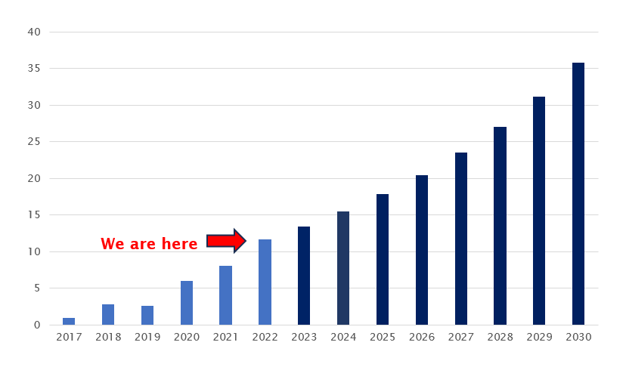
Calibrations in Collison
Repairable Estimates with a Calibration Entry
Source: CCC Crash Course Report
Notes:
Nick Dominato

Slide 18
Calibrations in Collison
Repairable Estimates with a Calibration Entry
Remember, 2 industry studies have found that 80%+ of calibrations are currently being missed by the industry!
Source: CCC Crash Course Report
Notes:
Nick Dominato

Slide 19
Collision Calibration Market: Big & Getting Bigger
2022
2026
2030
$1.4
Billion
$711
Million
$369
Million
9M Vehicles Repaired
(Baseline)
11.7% Calibration Rate = 1.05M calibrations
$350 Calibration Price
9.9M Vehicles Repaired (2.5% CAGR)
20% Calibration Rate = 2.03M calibrations
$350 Calibration Price
11M Vehicles Repaired (2.5% CAGR)
36% Calibration Rate = 3.9M calibrations
$350 Calibration Price
Source: CCC Crash Course Report
Notes:
Nick Dominato

Slide 20
ADAS & Calibration Developing Technology
Presented by:
Greg peeters, car adas solutions
Nick Dominito, I-Car
Chuck OlsEn, AirPro diagnostics
Notes:
Greg Peeters

Slide 21
Pedestrian deaths in US reach highest level in 40 years
Drivers struck and killed at least 7,508 people walking in 2022, which was the most pedestrian deaths reported since 1981. Since 2010, pedestrian deaths have increased 77%, compared to a 25% increase for all other traffic related deaths, according to the report.
The number of preventable deaths from bicycle transportation incidents increased 16% in 2020 and have increased 44% in the last 10 years, from 873 in 2011 to 1,260 in 2020.
In 2020, more than 76% of deaths with a known lighting condition were at night. Since 2014, nighttime pedestrian deaths have risen by 41%, from 3,510 in 2014 to 4,951 in 2020.
Notes:
Greg Peeters

Slide 22
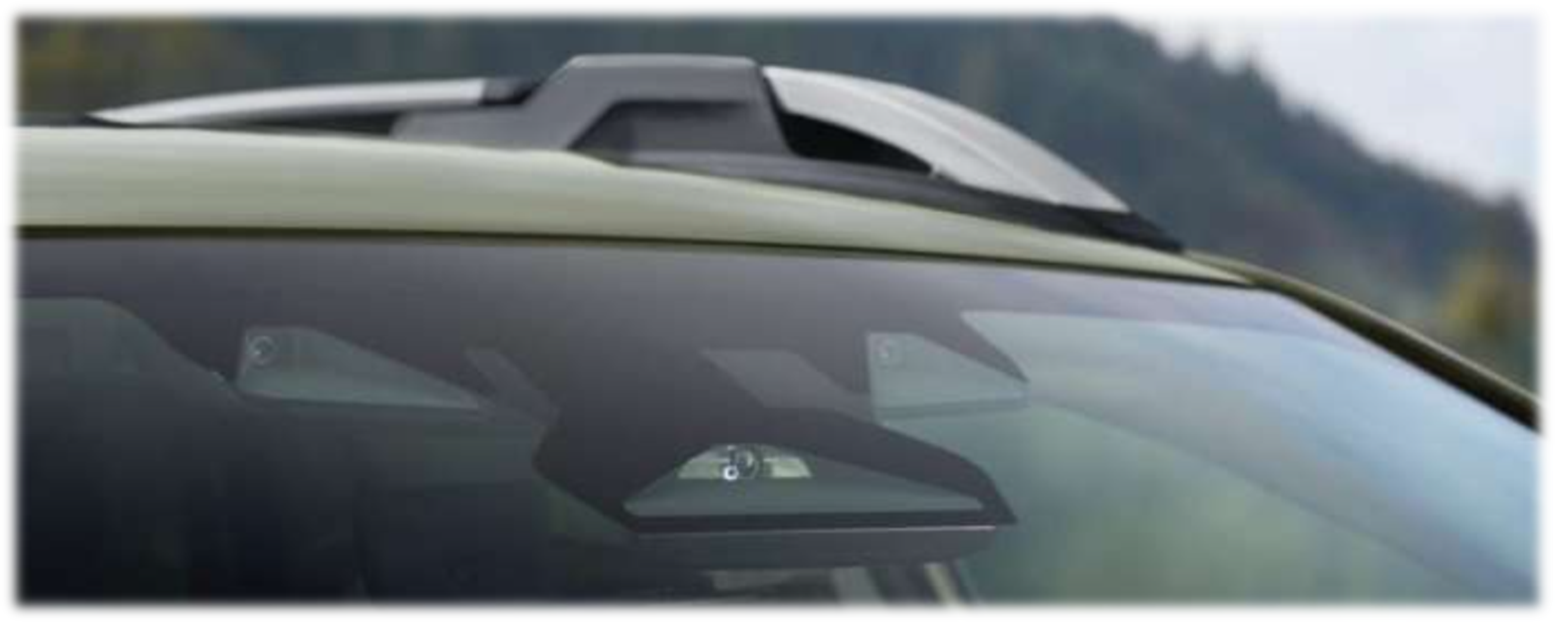
2023 Subaru Wide-Angle Mono Camera
Notes:
Greg Peeters

Slide 23
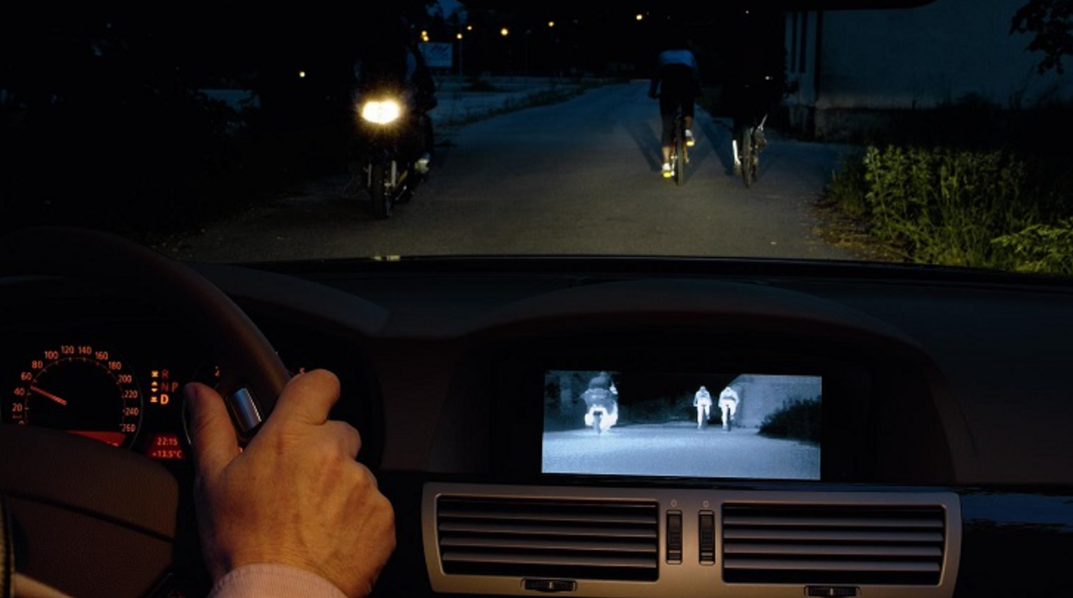
Night Vision
Passive Systems
(Thermal Imaging)
Audi/VW
BMW
Cadillac
Active Systems
(Infrared)
Toyota/Lexus
Mercedes
Notes:
Greg Peeters

Slide 24
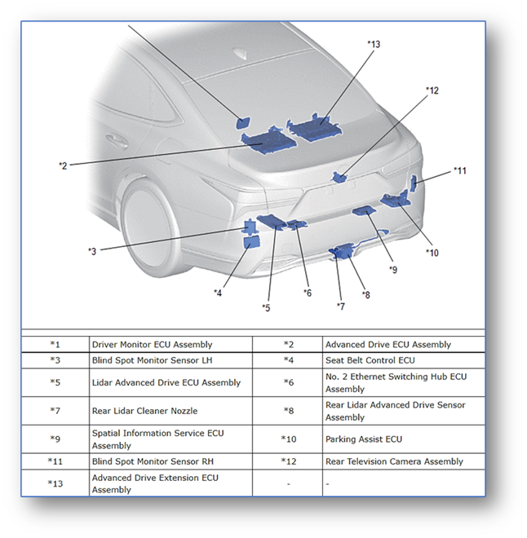
Lexus - Teammate
Advanced Park and Advanced Drive
SAE Level 2
Sensors = LiDAR, Radar, front and rear blind spot, 360 parking cameras, ultrasonic, forward camera with telescope
Driver monitoring
Integrated with GPS Mapping
LiDAR Calibration Procedure = 61 pages
Notes:
Greg Peeters

Slide 25
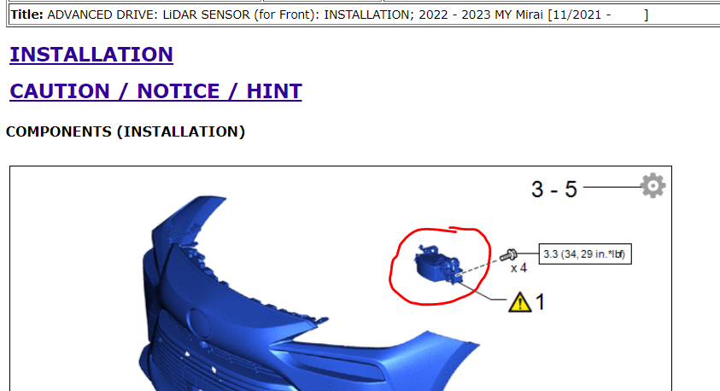
LiDAR
Notes:
Nick Dominato

Slide 26
Mercedes – Drive Pilot
  SAE Level 3
    First automaker to get permission from California regulators to sell or lease vehicles with level 3.
  Driver can legally take hands off wheel and eyes off road
    Daytime only
    Less than 40 miles per hour
    Interstate highway
    2024 S-Class and EQS Sedans
  Mercedes assumes liability of vehicle(if rules are followed)
  Uses Driver Monitoring System
  Sensors = Cameras, LiDAR, Radar, Ultrasound, audio mics, and GPS
Notes:
Greg Peeters

Slide 27
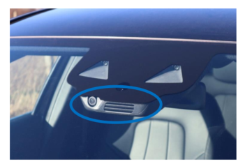
Mercedes Augmented Reality Cameras
Important Items
ARC must be calibrated when windshield is replaced
Often just a dummy camera – need to scan or pull build sheet to determine if it is equipped
Uses same target as lane departure cameras, same position and height, but
It is a separate procedure that must be initialized through the ARC module – doing the lane departure camera calibrations will not calibrate the ARC
Notes:
Nick Dominato

Slide 28
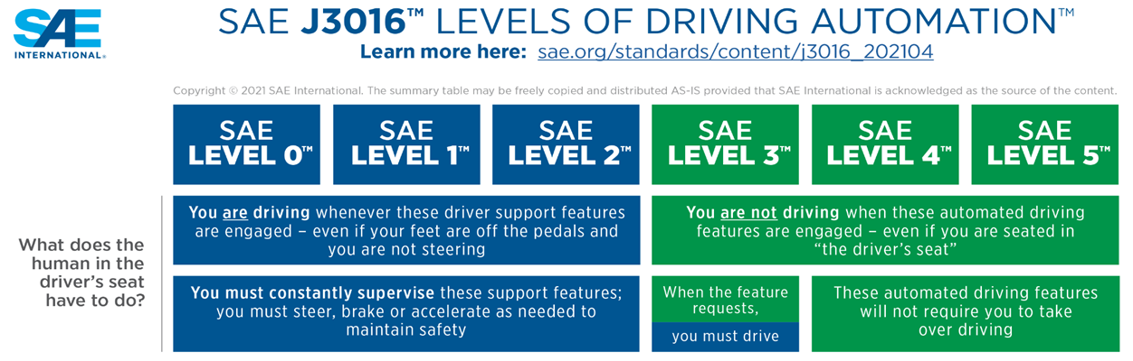
Autonomous Vehicle Update
Seven states—Florida, Georgia, Nevada, North Carolina, North Dakota, Utah, and West Virginia—do not require a driver behind the wheel or for the driver to be licensed if they are, providing that vehicle is deemed to be SAE Level 4 or 5 capable.
Notes:
Greg Peeters

Slide 29
Radar Power Tests
What is it?
It is a static function test to see if painting a bumper has reduced the power of the radar sensor too much.
Not a calibration.
Now being required after a bumper is painted for vehicles with 77 GHz blind spot radar.
Notes:
Nick Dominato

Slide 30
Radar Power Tests
Background
Corner radar systems have traditionally been 24 GHz
  Cheap, short range, low resolution
But we’re losing 24Ghz:
  Regulations
  We need better radar systems to support improved ADAS capabilities
New corner radars are 77 GHz
  Better range, resolution, accuracy
  Problem: we have a painted bumper in front of them now!
Old Systems | New Systems
“Is there a vehicle in the blind spot?” Resolution: 75cm | “Is there a cyclist or children in the blind spot?” Resolution: 4cm
Notes:
Nick Dominato

Slide 31
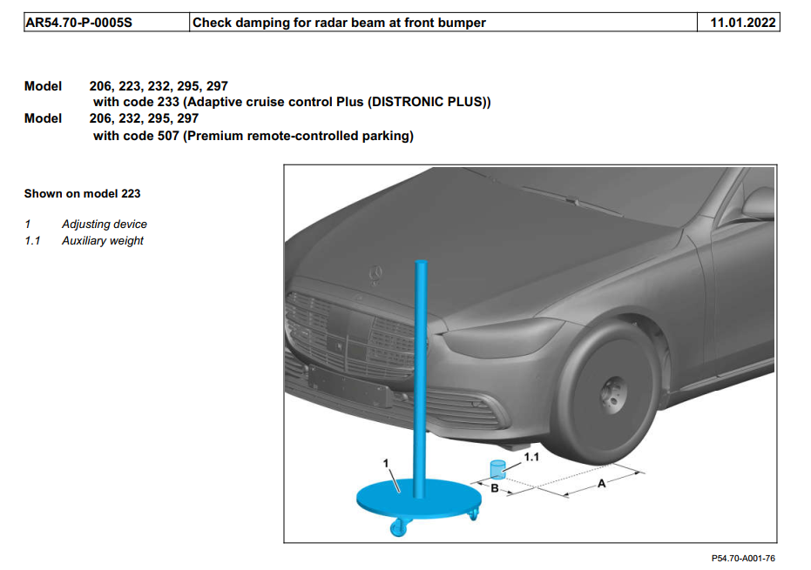

Radar Power Tests - Mercedes
Notes:
Nick Dominato

Slide 32
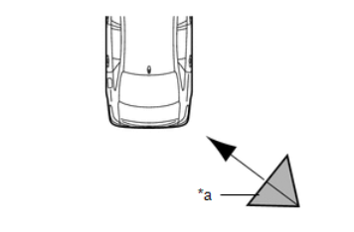
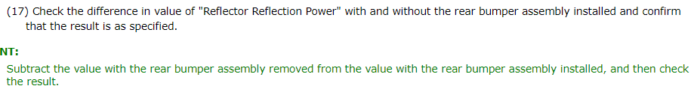
Radar Power Tests - Toyota
Notes:
Nick Dominato

Slide 33

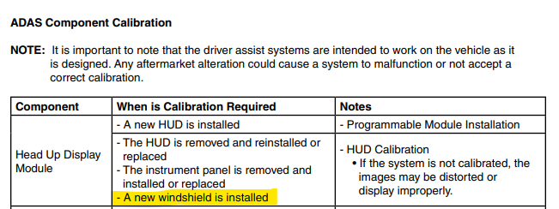
Ford HUD
Notes:
Nick Dominato

Slide 34
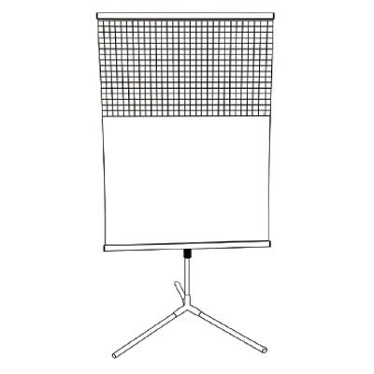
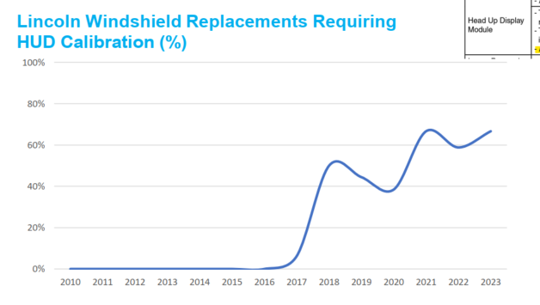
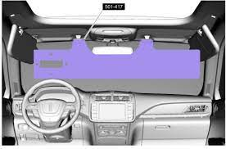
Ford HUD

Slide 35
Updated Windshield replacement calibration requirements
https://agsc.org/wp-content/uploads/2022/10/ANSIAGSCAGRSS005-2022.pdf
The Auto Glass Safety Council is an accredited American National Standards Institute (ANSI) standards development organization. It has developed North America’s only auto glass replacement standard, the AGRSS™ Standard (ANSI/AGSC/AGRSS 005-2022 Automotive Glass Replacement Safety Standard). The AGRSS Standard addresses procedures, education and product performance. It is a continuous maintenance standard.
FLORIDA - Glass companies must provide customers with an electronic or written notice, in at least 12-point type, as to whether the recalibration of the ADAS is required to make the ADAS operable and must perform any necessary recalibration to meet or exceed vehicle manufacturer’s specifications.
ARIZONA - Specifies that if a recalibration was not performed or completed successfully the facility must inform the customer and the customer's insurer electronically or in writing that the recalibration was not done or successful and that the vehicle should be taken to a vehicle manufacturer's certified dealership or a qualified facility capable of performing the recalibration of the specified system that meets or exceeds the vehicle manufacturer's specifications.
MARYLAND The new calibration law will require glass shops to inform customers, before repairing or replacing auto glass, if recalibration is required and to provide a written statement that the work will meet or exceed original equipment manufacturer specifications. Afterward, the glass shop must inform the customer if the recalibration was not performed or successfully completed. The law will also require that the recalibration meet or exceed the motor vehicle manufacturer’s specifications. The glass company may not charge for calibrations not completed or not performed.
ILLINOIS - no insurer shall require advanced driver assistance system calibration that does not meet or exceed original equipment manufacturer specifications for such automobile glass. However, this subsection does not require the use of original equipment manufacturer repair specifications that unreasonably restrict access to a repair facility subject to this Section.
UTAH - If a vehicle is equipped with an advanced driver assistance feature, an automotive glass company or repair facility approving or conducting glass repair, replacement, or recalibration on the vehicle shall: (a) before approving or performing a vehicle glass repair or replacement, inform the consumer in electronic or hardcopy writing if a recalibration of the advanced driver assistance feature: (i) is required; or (ii) will be performed; and (b) if performing a recalibration of an advanced driver assistance feature, meet or exceed the manufacturer's specifications.
Notes:
Chuck Olsen

Slide 36
Windshield related Calibration VS. Collision related Calibration
Diagnostic/Troubleshooting and Repair
Option content
Comprehend collision repair and/or windshield replacement estimate to evaluate what calibrations are required
Service information resources
  Re-Calibration vs Calibration
  Types of calibrations (Static/Dynamic/Both)
  Calibration vs Re-Calibration
  Systems/Components to be Calibrated (Radars, cameras, etc.)
  Features effected (Lane keep, adaptive cruise, AEB, surround view)
Sensor adjustments
  Before calibration
  Additional repairs needed when calibration or system performance is affected
Equipment, Space and environmental requirements
Notes:
Chuck Olsen

Slide 37
SEMA Modified Truck ADAS Research
NHTSA Update (Automatic Emergency Braking)
Presented by: Mike Muller
ADAS Engineer, SEMA Garage Detroit
Notes:
Mike Muller

Slide 38
SEMA Modified Truck ADAS Research
Notes:
Mike Muller

Slide 39
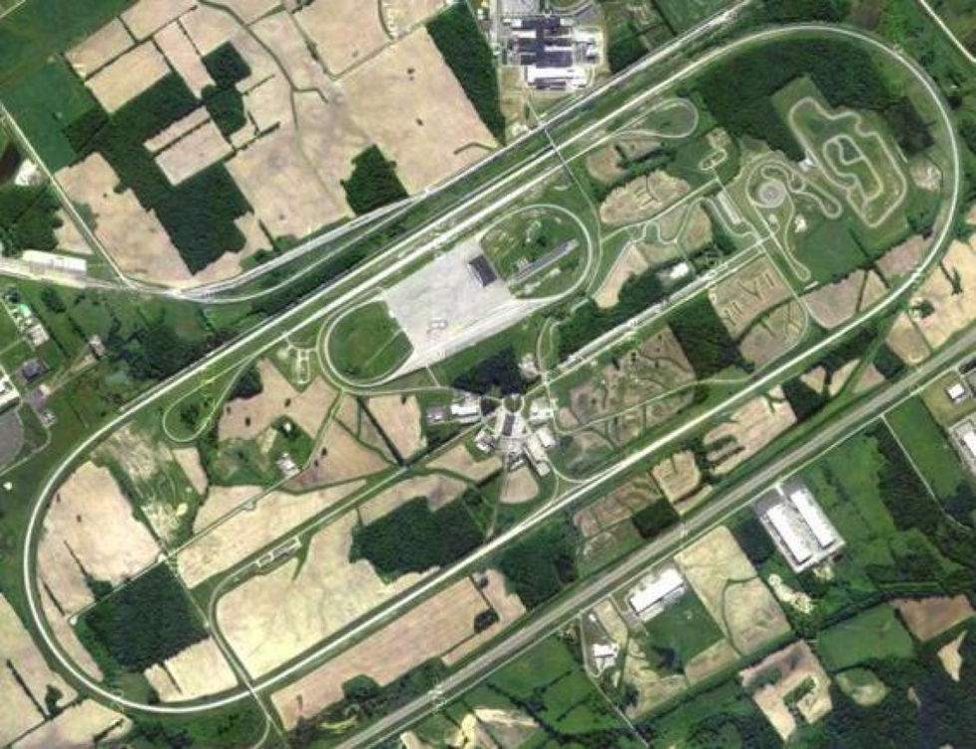
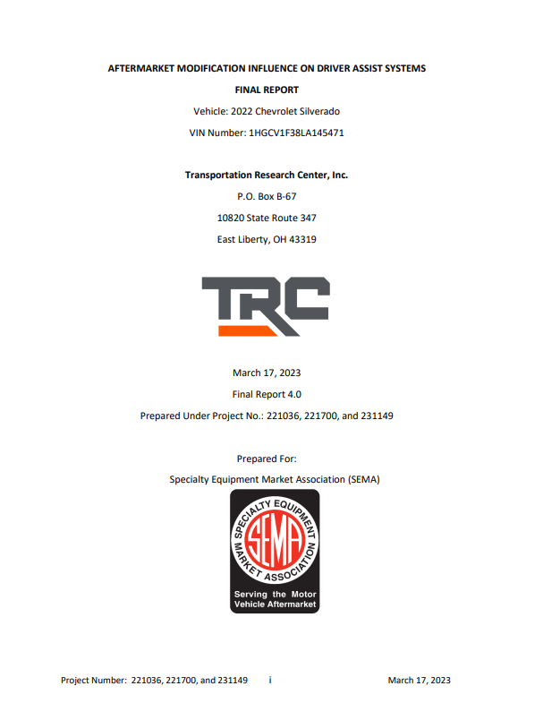
SEMA Modified Truck ADAS Research
Aftermarket Modification Influence on Driver Assist Systems
Notes:
Mike Muller

Slide 40
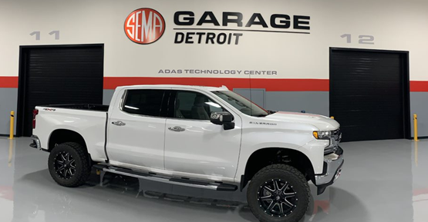
SEMA Modified Truck ADAS Research
Aftermarket Modification Influence on Driver Assist Systems
2022 Chevy Silverado LTZ
Model:
CK18543-2022 SILVERADO
1500 LTD CREW CAB 4WD

Slide 41
SEMA Modified Truck ADAS Research
Aftermarket Modification Influence on Driver Assist Systems
Goal: Compare & Contrast
Time/Distance @ ADAS ALERT
Time/Distance @ ADAS ACTION
  Stock Vehicle
  2” Level kit
  3.5” Lift kit
  6” Lift

Slide 42
SEMA Modified Truck ADAS Research
Overview of Test Scenarios
Each of the four test configurations was assessed in a series of established ADAS testing scenarios extracted from NHTSA New Car Assessment Program (NCAP) to record performance. The tests included:
Notes:
Mike Muller

Slide 43
SEMA Modified Truck ADAS Research
Overview of Test Scenarios
Each of the four test configurations was assessed in a series of established ADAS testing scenarios extracted from NHTSA New Car Assessment Program (NCAP) to record performance. The tests included:
Lane Departure Warning (LDW)
  For both left & right lane departure
  NHTSA Lane Departure Warning system Confirmation Test, February 2013
Lane Keep Support (LKS)
  NHTSA Lane Departure Warning System Confirmation Test, February 2013
Crash Imminent Braking (CIB) = Automatic Emergency Braking (AEB)
  NHTSA Crash Imminent Brake System Performance Evaluation for the New Car Assessment Program October 2015
Traffic Jam Assist (TJA)
  NHTSA Traffic Jam Assist System Confirmation Test (Working Draft) July 2019
Blind Spot Detection (BSD)
  NHTSA Blind Spot Detection System Confirmation Test (Working Draft) May 2020
Rear Cross Traffic Alert (RCTA)
  Custom test procedure, set-up as below, with concept from similar global tests – i.e. EuroNCAP or similar procedure

Slide 44
SEMA Modified Truck ADAS Research
Nomenclature standardization:
Notes:
Mike Muller

Slide 45
SEMA Modified Truck ADAS Research
Testing Summary
For the tests completed, the different modifications assessed exhibited acceptable behavior with variations occurring only in the spread of the data, but do not rise to the level of a systemic difference.
Per the NCAP Performance Evaluation & Confirmation Tests criteria the variation is acceptable.
Next Steps:
Results: Virtual Education Session September 14th
Detailed Results: SEMA Show White Paper, October 31-November 4th
Disclaimer: The results is for the specific 2022 Chevy Silverado LTZ vehicle used in the SEMA Garage research and the aforementioned modifications ONLY and shall not be construed to indicate ANY future results for any other vehicle or modification.

Slide 46
NHTSA Update (Automatic Emergency Braking)
AGENCY:
National Highway Traffic Safety Administration (NHTSA), Department of Transportation (DOT).
ACTION:
Notice of proposed rulemaking (NPRM).
Publication Date:
06/13/2023
SUMMARY:
This NPRM proposes to adopt a new Federal Motor Vehicle Safety Standard to require automatic emergency braking (AEB), including pedestrian AEB (PAEB), systems on light vehicles.
Notes:
Mike Muller

Slide 47
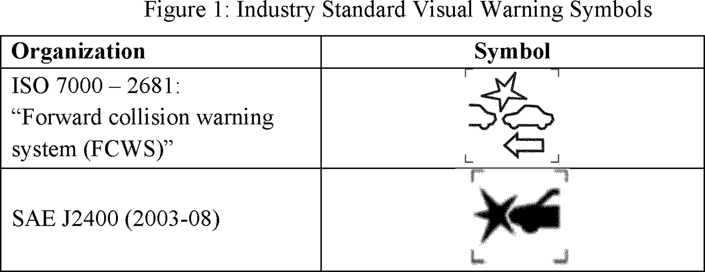
NHTSA Update (Automatic Emergency Braking)
AGENCY:
National Highway Traffic Safety Administration (NHTSA), Department of Transportation (DOT).
ACTION:
Notice of proposed rulemaking (NPRM).
Publication Date:
06/13/2023
SUMMARY:
This NPRM proposes to adopt a new Federal Motor Vehicle Safety Standard to require automatic emergency braking (AEB), including pedestrian AEB (PAEB), systems on light vehicles.
Federal Register :: Federal Motor Vehicle Safety Standards: Automatic Emergency Braking Systems for Light Vehicles

Slide 48
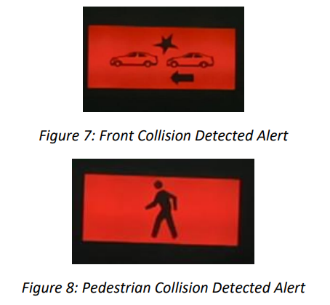
NHTSA Update (Automatic Emergency Braking)
AGENCY:
National Highway Traffic Safety Administration (NHTSA), Department of Transportation (DOT).
ACTION:
Notice of proposed rulemaking (NPRM).
Publication Date:
06/13/2023
DOCUMENT LINKS:
https://www.govinfo.gov/content/pkg/FR-2023-06-13/pdf/2023-11863.pdf
Automatic Emergency Braking Systems | Notice of Proposed Rulemaking (nhtsa.gov)
SEMA Silverado

Slide 49
NHTSA Update (Automatic Emergency Braking)
PROPOSED COMPLIANCE DATE:
Vehicles manufactured on or after September 1, four years after the publication date of a final rule, would be required to meet all requirements. Vehicles manufactured on or after September 1, three years after the publication date of a final rule, but before September 1, four years after the publication date of a final rule, would be required to meet all requirements except that lower speed PAEB performance test requirements specified in S5(b) would apply.
Small-volume manufacturers, final-stage manufacturers, and alterers would be provided an additional year (added to those above) to meet the requirements of the final rule.
Early compliance is permitted but optional.
Federal Register :: Federal Motor Vehicle Safety Standards: Automatic Emergency Braking Systems for Light Vehicles
Notes:
Mike Muller

Slide 50
NHTSA Update (Automatic Emergency Braking)
ADAS Stakeholders - Who has Overall ADAS System Responsibility for the vehicle?
    Glass companies
    Collision repair shops
    Aftermarket Parts Manufacturer
    Aftermarket Installer
    OEM’s / Tier 1 OEM Suppliers
    State / Federal Legislators - legislation
    Insurance companies
    ADAS recalibration centers
    IAM calibration equipment manufactures
    Consumer….

Slide 51
NHTSA Update (Automatic Emergency Braking)
What does it mean to CIC?
Notes:
Mike Muller

Slide 52
NHTSA Update (Automatic Emergency Braking)
What does it mean to CIC?…..TBD
Similar Precedence’s: TPMS, Backup Camera, Electronic Stability Control
https://www.nhtsa.gov/sites/nhtsa.gov/files/tpmsfinalrule.pdf
https://www.transportation.gov/briefing-room/nhtsa-announces-final-rule-requiring-rear-visibility-technology
https://www.nhtsa.gov/sites/nhtsa.gov/files/fmvss/ESC_FR_03_2007_0.pdf

Slide 53

NHTSA Update (Automatic Emergency Braking)
What does it mean to CIC?…..TBD
Similar Precedence’s: TPMS, Backup Camera, Electronic Stability Control
https://www.nhtsa.gov/sites/nhtsa.gov/files/tpmsfinalrule.pdf
https://www.transportation.gov/briefing-room/nhtsa-announces-final-rule-requiring-rear-visibility-technology
https://www.nhtsa.gov/sites/nhtsa.gov/files/fmvss/ESC_FR_03_2007_0.pdf
Notes:
Mike Muller

Slide 54
Progression of ADAS safety systems…now and into the Future
Q&A
Panel Discussion
Notes:
Chuck Olsen: Introduce session, Thank all committee members

Slide 55
Audience Response Question:
What Future ET Topics would interest you most (vote for up to 4)
Estimating Technologies (AI)
Updated Scanning and Diagnostic methods /tools
Vehicle Cybersecurity
Policies/Regulations effecting new technologies
Service/repair information updates
Over the air updates
Vehicle build data/records/blockchain
Infotainment/vehicle integration apps (Google/Apple/Microsoft)
EV diagnostic strategies
Subscription based vehicle features
LEAVE THIS AREA FOR THE RESPONSE RESULTS

