Slide 1
Required Changes to Refinish Operations Panel Discussions
Emerging Technologies (Analog)
Presented by:
Scott VanHulle

Slide 2
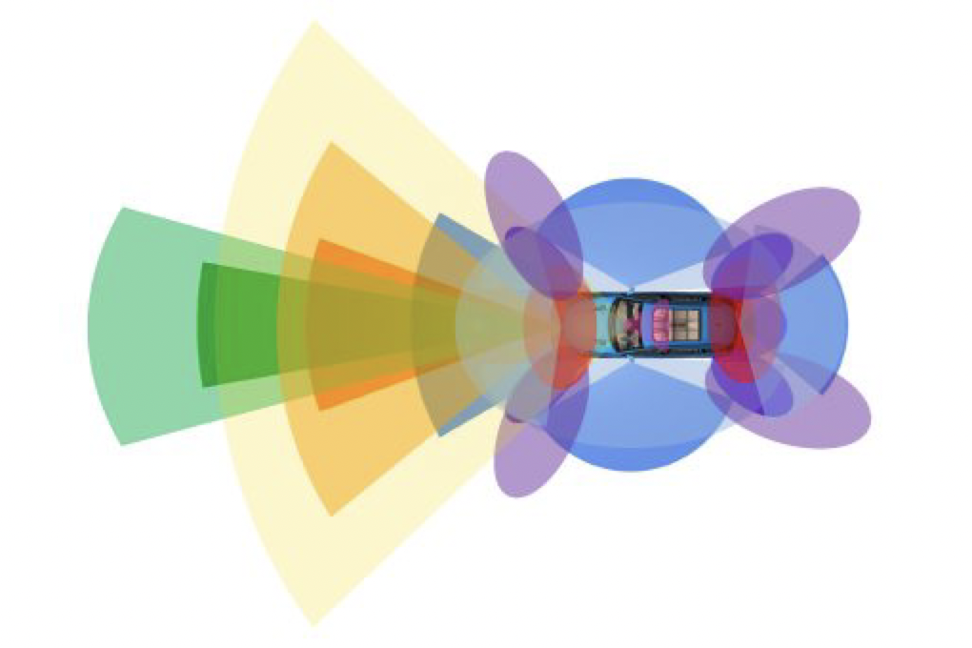
History
March 2016 U.S. DOT and IIHS announce commitment of 20 automakers to make automatic emergency braking standard on new vehicles
Radar sensors found on almost all new vehicles
Industry questions increasing
Issues calibrating after repairs
Come backs
New technology

Slide 3
Panel Discussion
AkzoNobel – Tracy Frye – Technical Consultant
Sherwin-Williams – Gary Kilby - Technical Training Manager
BASF – Jeff Wildman – Expert, Automotive Aftermarket Industry at BASF

Slide 4
What affect do the toners have on the radar?
Is it only metallic toners that can cause a problem with radar?
Can undercoats cause a problem with the radar?
Is total film build a problem, or just the thickness of the basecoat?
Can Mica cause a problem?

Slide 5
What are some common procedures/information that you see from the OEMs?
What are some of the common procedures on prepping and refinishing around radar?
Always follow paint makers and OEM procedures/position statements.

Slide 6
What are the refinish companies doing to deal with this issue?
What steps do you recommend if there is a color match issue?
Are you developing special formulas just for parts with radar?
When a refinish technician looks up a paint code in the computer, are there any warnings or information about refinishing around radar?

