Slide 2
A Journey Towards Collaborative Solutions
Estimating Committee
Presented by:
Chair - Danny Gredinberg
Co-Chair- Princess Erin Solis
Notes:
Introduction:
Introduce new Committee Co Chair!

Slide 3
Committee Members: Estimating Committee
Aaron Schulenburg - SCRS
Andrew Batenhorst – Pacific BMW Collision
Barry Dorn – Dorn's Body and Paint
Brandon Mehdizadeh – LaMettry’s
Bud Center - I-CAR
Chad Sulkula – CCC
Charlie Whittaker
Cody Rinaudo – Franks Accurate Body Shop
Connie Hutton – Erie Insurance
Danny Gredinberg (Committee Chairman) – Database Enhancement Gateway
Daniel Panduro – Fix Auto
Daniel Williams – MOTOR
David Willett – Spark Underwriters
Erin Solis (Committee Co-Chair) – Certified Collision Group
Ian Morton- Fix Auto
Jerry Gastineau – Mitchell
John McDonald – MOTOR
John Strong- Mitchell
Joseph Phillippi- Body Builders Auto
Kyle Motzkus- Hunter Auto Body
LeRoy Hamilton – Acuity Insurance
Mike Anderson – Collision Advice
Michael Bergeron – MOTOR
Michael Bradshaw – KM Collision
Mitchell Koop – MOTOR
Rich O’ Leary – FIX Auto
Rob Wagner – Rob Wagner Auto Body
Roger Cada – Accountable Estimating
Ron Perretta – Professionals Auto Body
Ron Reichen – Precision Body and Paint
Steve Bielecki - MOTOR
Steve Krieps – Collision Safety Consultants WV
Tracy Dombrowski – Collision Advice
Will Lattuff – Lattuff Brothers Autobody
Notes:
Thank our committte members

Slide 4
An Evolution is Occurring
Notes:
A evolution is occurring right now. If you are confused as to what…

Slide 5
Do these two terms belong in the same environment?
Estimate
Repair
Plan
Estimate
Repair Plan
Notes:
Do Estimate and Repair Plan belong in the same environment?
The answer is NO. They two completely different from each other. Lets explore the difference in antiquated term used.

Slide 6
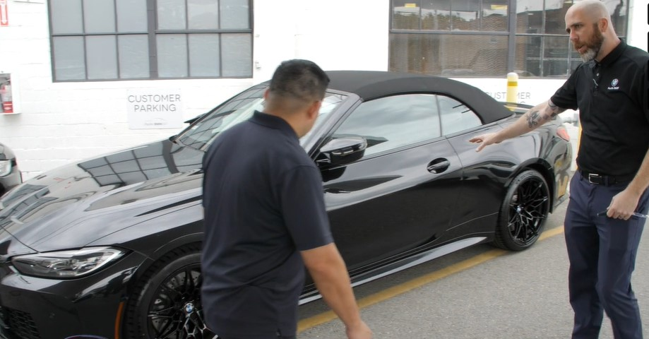
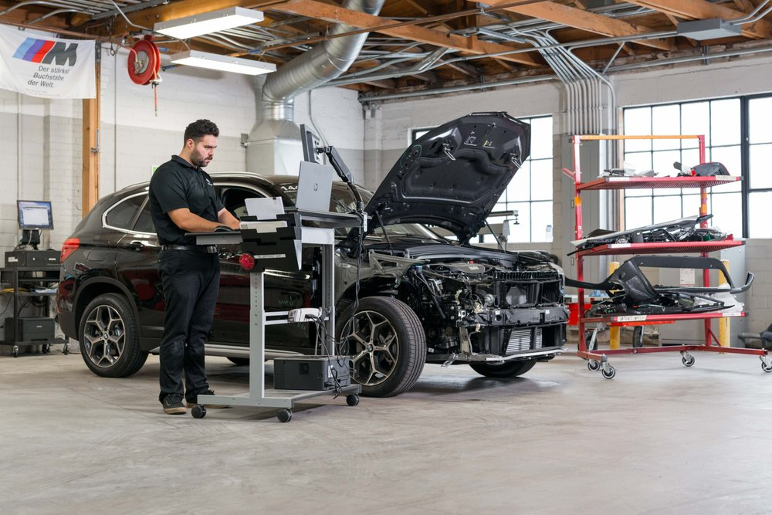
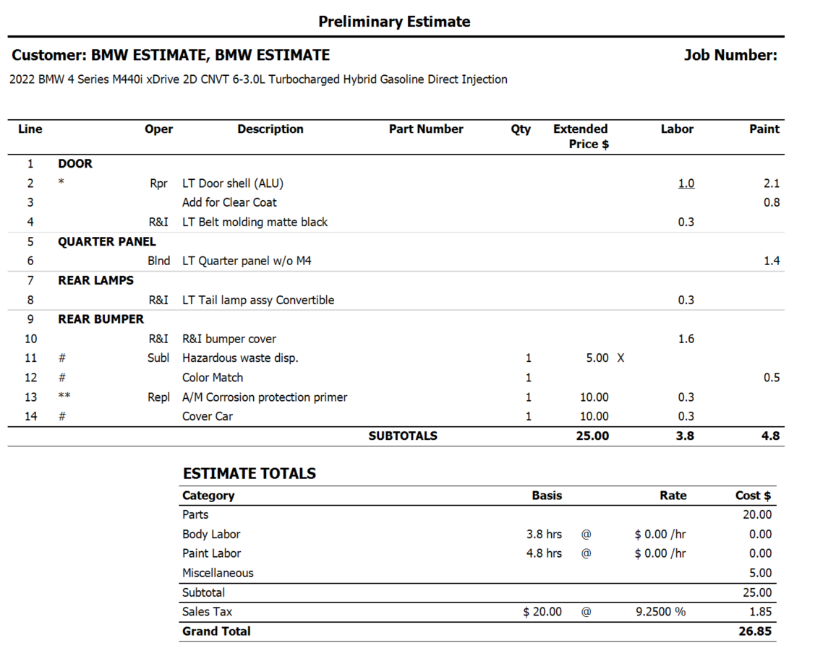
ESTIMATE
REPAIR PLAN
Notes:
Examples of Estimate vs Repair Plan.
Estimate is typically done before the vehicle is taken apart.
Don’t by Insurance Appraiser, Body Shop (est appointment), Virtual inspection. Minimal interaction with OE service information.
Repair plan is more in depth requiring the vehicle to be 100% Disassembled

Slide 7
What is currently defined?
Notes:
Point to CIC Wiki Link

Slide 8
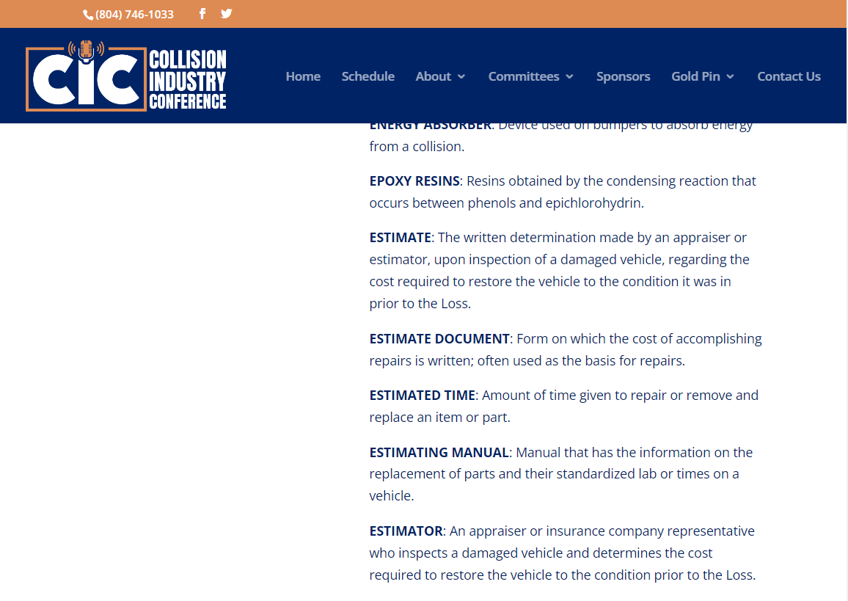
Current CIC definition: Estimate
ESTIMATE: The written determination made by an appraiser or estimator, upon inspection of a damaged vehicle, regarding the cost required to restore the vehicle to the condition it was in prior to the Loss.
Notes:
Recap current definition in CIC WIKI

Slide 9
Notes:
As a committee we got together and had some great conversation. Something along the lines of this. We all ended up meaning the same thing, but had a different way of explaining it for the same end result.

Slide 10
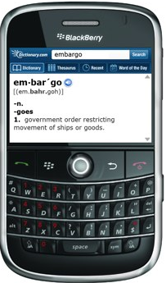
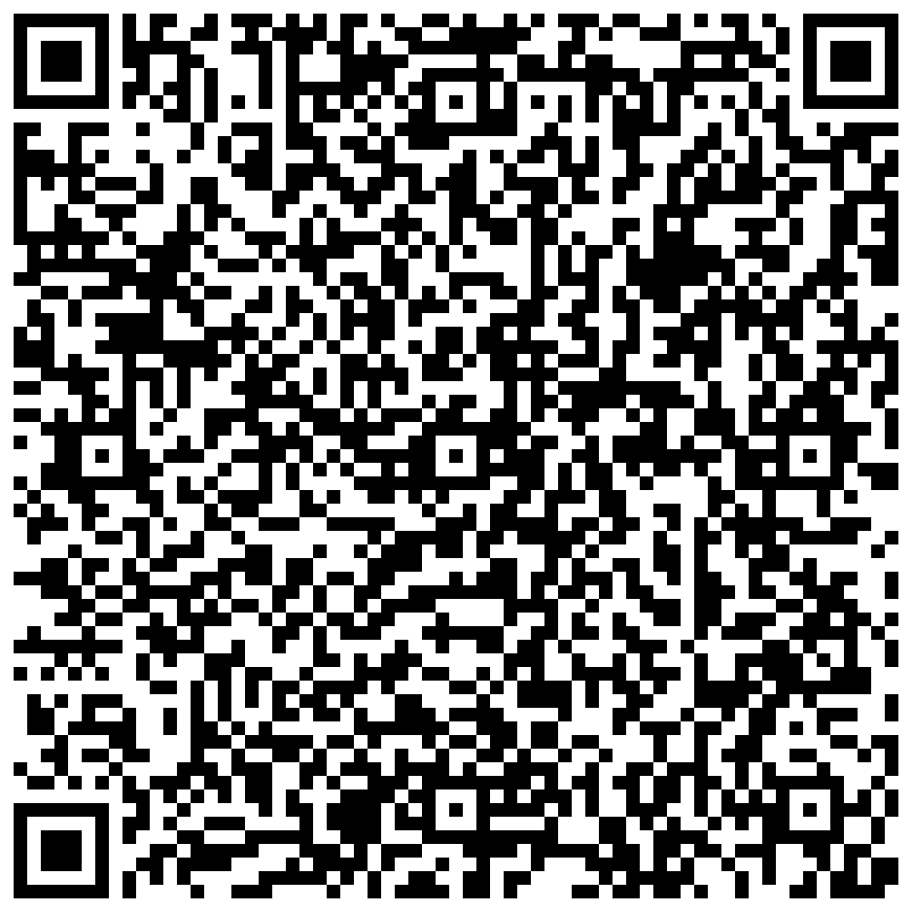
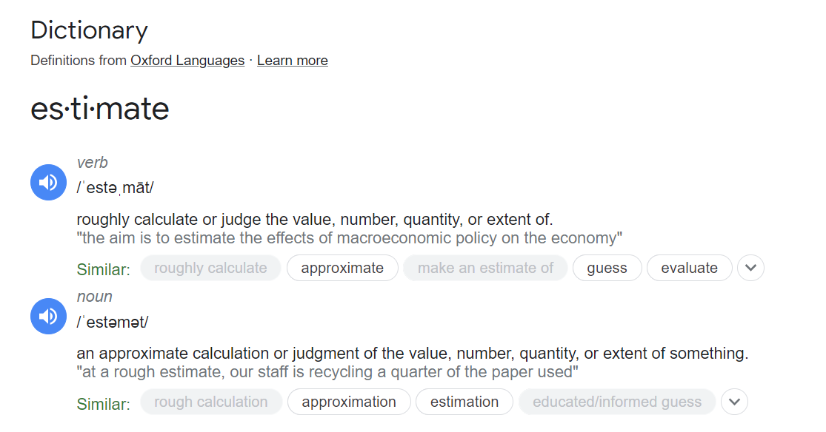
What does “Estimate” Really Mean?
Estimate

Slide 11
Notes:
A preliminary statement of the approximated cost of based on a preliminary inspection of visible damage.

Slide 12
Suggestions for CIC WIKI
“Identifies damages, based on the facts of the loss/event. Provides a preliminary estimate, based only on the visible damages without performing any disassembly. The estimate is then created with the use of an information provider estimate database guide without full use of OEM repair information.”

Slide 13
Suggestions for CIC WIKI
“A preliminary statement of the approximated cost based on a preliminary inspection of visible damage.”

Slide 14
Audience Response Question: Should the CIC Definition for “Estimate” be updated?
LEAVE THIS AREA FOR THE RESPONSE RESULTS
Agree
Disagree
Abstain

Slide 15
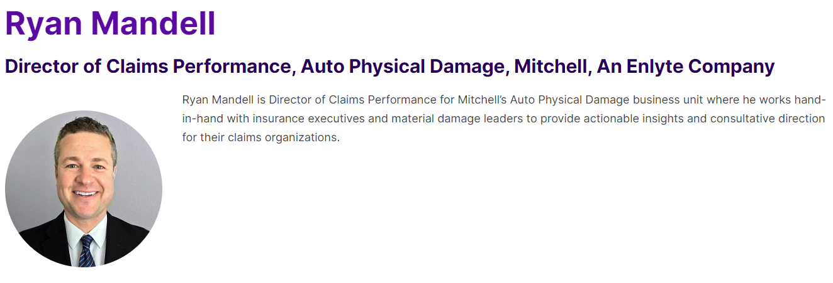

Slide 16
Industry Innovation: Crowd-Sourced Estimating
Claims Model Evolution
DRP
13.3 Days
Field Staff
2.7 Days
Cycle Time: Assign to Original Commit
Virtual
0.4 Days
Collective
10 Minutes
“Collective” virtual appraisal solution is currently being marketed to the broader insurance market

Slide 17
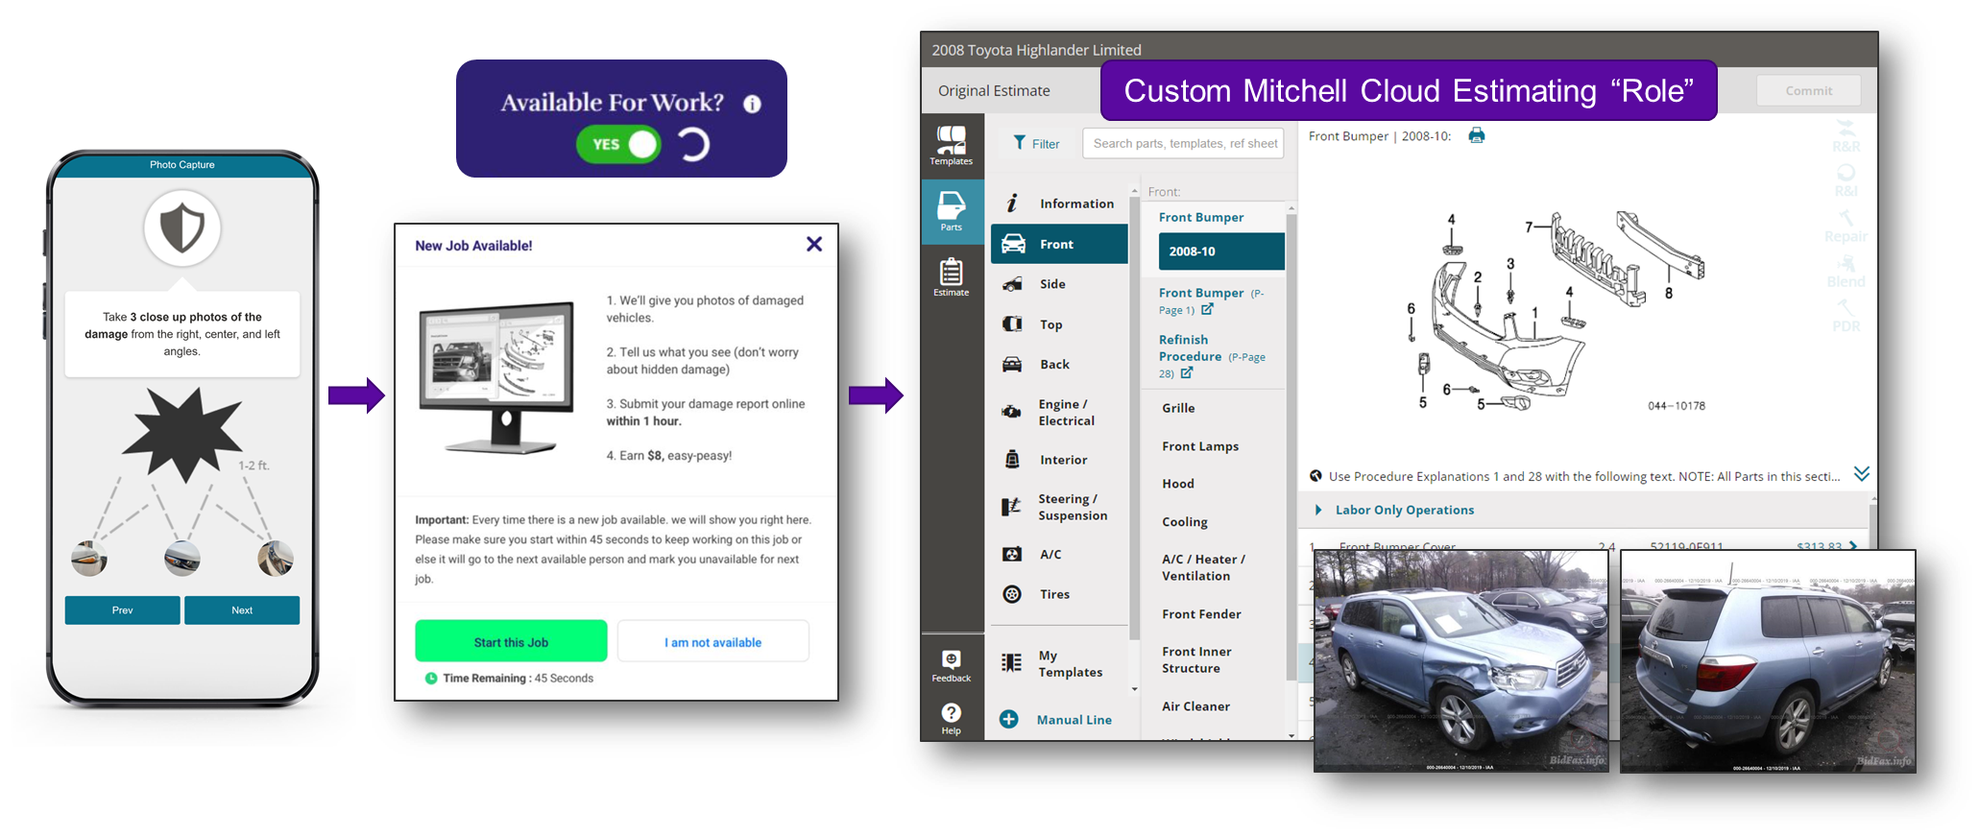
Crowd-Sourced Estimating: Inside Look
Claims Model Evolution

Slide 18
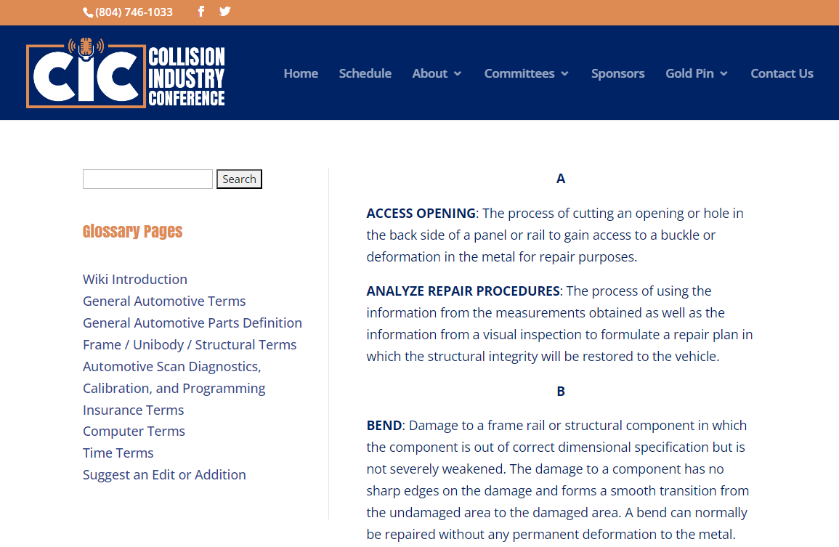
We have an Issue!
“Repair Plan”
is only mentioned one time in the CIC WIKI

Slide 19
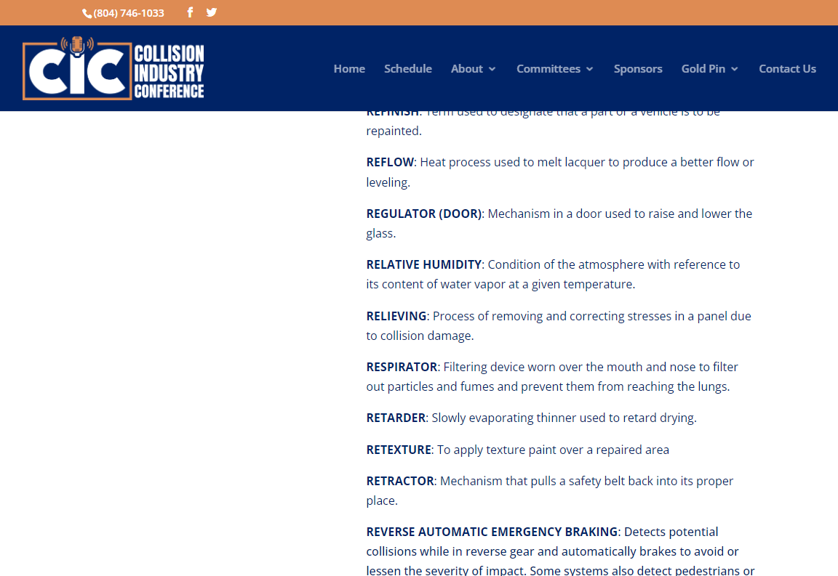
Lets squeeze in a new term: Repair Plan

Slide 20
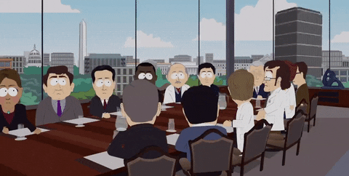
We went straight to work

Slide 21
Steps to Perform “Repair Planning”
Researching to identify available OEM repair information, based on the damages including substrate types
Wash the vehicle so all damages can be exposed.
Pre-Scanning the vehicle, to identify electrical damages from the event through identified DTC codes.
Analyzing all damages prior to and during a 100% disassembly.
Cont.

Slide 22
Measuring vehicle suspension/ alignment
Measuring the vehicle structure
Identify the electrical damages by referencing OEM procedures required for analysis and system correction.
Analyze and apply the OEM procedures to identify additional labor operations that fall outside of the included operations for the parts that require replacement, R&I or sacrificial panels.
Cont.

Slide 23
Capturing the evidence, with images, that identifies the damage transfer from point of impact to adjacent components.
Color Verification & Replication (steps may vary)
Material / Consumables to be used
In Process Scan/ Guided Fault Diagnostic Research
Information Provider Validation

Slide 24
What is “Repair Plan”?
“Identifies ALL damages, based on the facts of the loss/event. This means not only the point of impact, but damages transmitted to other areas of the vehicle based on the designed load path. This includes an inspection of the interior and cargo areas based on inertia of occupied seating and items being transported in the cargo or passenger compartment.
The Repair Plan is finalized with the use of all captured data from the vehicle and all relevant OEM repair procedures along with the information provider estimating database guide.”

Slide 25
What is “Repair Plan”?
“A comprehensive document expressing the full extent or operations and actual cost of the repair, and repair process.”

Slide 26
Audience Response Question: Should CIC WIKI include a definition for “Repair Plan”
LEAVE THIS AREA FOR THE RESPONSE RESULTS
Agree
Disagree
Abstain

Slide 27
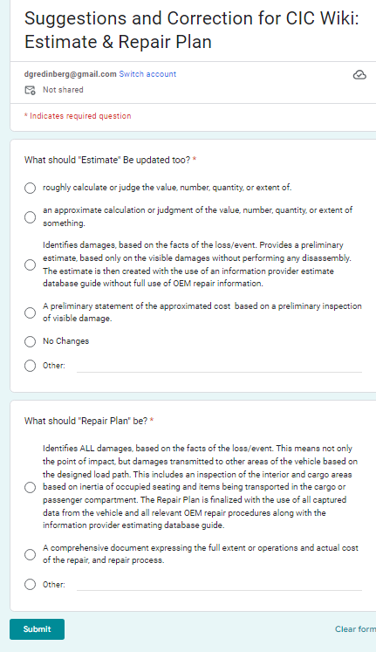
https://forms.gle/o8QArzfSBToDfKQD8
Deadline for Submission
Sept 30, 2023

Slide 28
Please submit responses to:
Danny G: Admin@Degweb.org
Erin Solis: Esolis@certifiedcg.com

Slide 29
Thank You!

