Slide 1
Telematics Myth Busting: PT2
Future Disruptions Committee
Presented by:
Co-Chair: Jimmy Spears (Tractable)
Co-Chair: Gabriel Morley (DEKRA)

Slide 2
Future Disruptions Committee
Mission: Identify, share and drive discussions regarding future trends, technologies, disruptions, business models, and concepts that can and will disrupt all industry segments within 5-10 years. By identifying and sharing this information this committee hopes to help all segments prepare for and find common ground to deliver solutions that ensure the consumer’s experience and safety meets or exceeds their expectations.
Presented by:
Co-Chair: Jimmy Spears (Tractable)
Co-Chair: Gabriel Morley (DEKRA)

Slide 3
2023 Future Disruptions Committee
**no Particular order
Committee Members:
Jake Rodenroth: Lucid Motors Rick Palmer: ComputerLogic
Frank Terlep: Auto Techcelerators, LLC. David Willett: Spark
Trent Tinsley: Entegral Michael LoPrete: Plastfix Industries
Fred Iantorno: AirPro Diagnostics Jimmy Spears: Tractable
Dirk Fuchs: I-CAR Donald Finley: CSAA
Sean Carey: SCG Management Consultants LLC Gabriel Morley: DEKRA
Karl Kirschenman: Spanesi
Greg Potter: ETI
Sandy Blalock: ARA
Taylor Moss: OEC
Presented by:
Co-Chair: Jimmy Spears (Tractable)
Co-Chair: Gabriel Morley (DEKRA)

Slide 4
A series about “The Future of Telematics”: The Future Disruptions Committee Myth Busters presentations will try to cut through the “hype”, “vaporware” and “sales pitches” on vehicle telematics and present the "real" capabilities of vehicle Telematics today.
Myth Busting: Pt1
Myth Busting: Pt2
Myth Busting: Pt3
What is telematics?
History of telematics
Telematic systems available today
In vehicle
App based
Other
What today’s telematic systems really do
What we can expect in the future
Industry leaders discussing the impacts and implications of real world telematic data usage and technologies
45Min Panel
Let’s hear from those implementing and manufacturing Telematics within Vehicles!
Q4 2022
Q1 2023
Today!

Slide 5
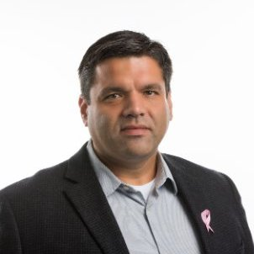
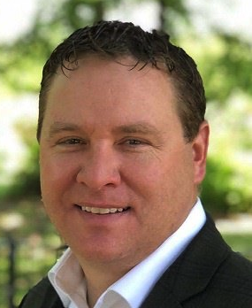
Benito Cid
Mercedes Benz
Collision Programs Manager
Kelly Logan
Rivian
Director Collision Repair Programs

Slide 6
Future Disruptions Committee
THANK YOU
If you are passionate about the future, willing to contribute and are interested in joining the committee, please contact:
Frank Terlep: fterlep@autotechcelerators.com
Jimmy Spears: James.Spears@Tractable.AI
Gabriel Morley: gabrielmorley@gmail.com

