Slide 1
Blend Study – the Sequel!
CIC Parts & Materials Committee
Presented by:
Aaron Schulenburg, SCRS

Slide 2
Parts & Materials Committee
Barry Dorn, Dorn’s Body & Paint
Benito Cid, Mercedes-Benz
Bradley Khodadadeh, Advantage Parts Solution
Braxton Ewing, BASF
Brian Tenley, Rydell Auto
Chris Sestito, Premiere Services
Dale Sailer, Empire Auto Parts
Dan Tessadri, CSAA
Don Porter, URG
Greg McDowell, Mitchell
Greta Houlahan, Car-Part.com
Jason Scharton, 3M
Jay Tannenbaum, Headlight Depot
Jerry Gastineau, Mitchell
John Strong, Mitchell
Justin Clark, LKQ
Ken Weiss
Mark Allen, Audi
Michael Lanza, Sherwin-Williams
Paul Barry, CIECA
Paul Folino, LKQ
Paul Sgro, Lee’s Garage
Rick Palmer, Computer Logic
Rod Sproule, Manitoba Public Ins.
Ryan Mandell, Mitchell
Sandy Blalock, ARA
Stacy Bartnik, Intertek
Tim Ronak, AkzoNobel
Virginia Whalen, ARA

Slide 3
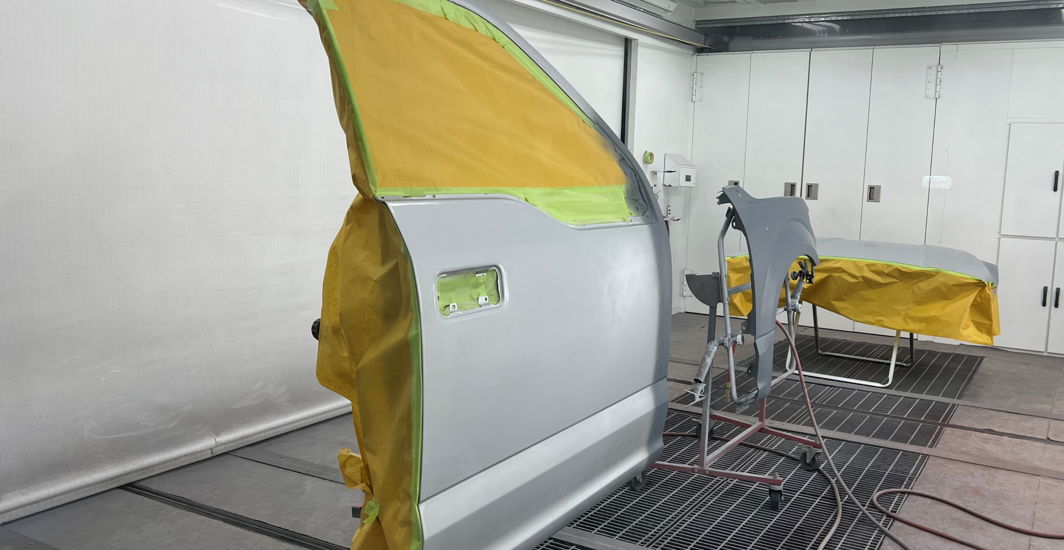
BLEND ADJACENT PANEL FOR COLOR MATCH

Slide 6
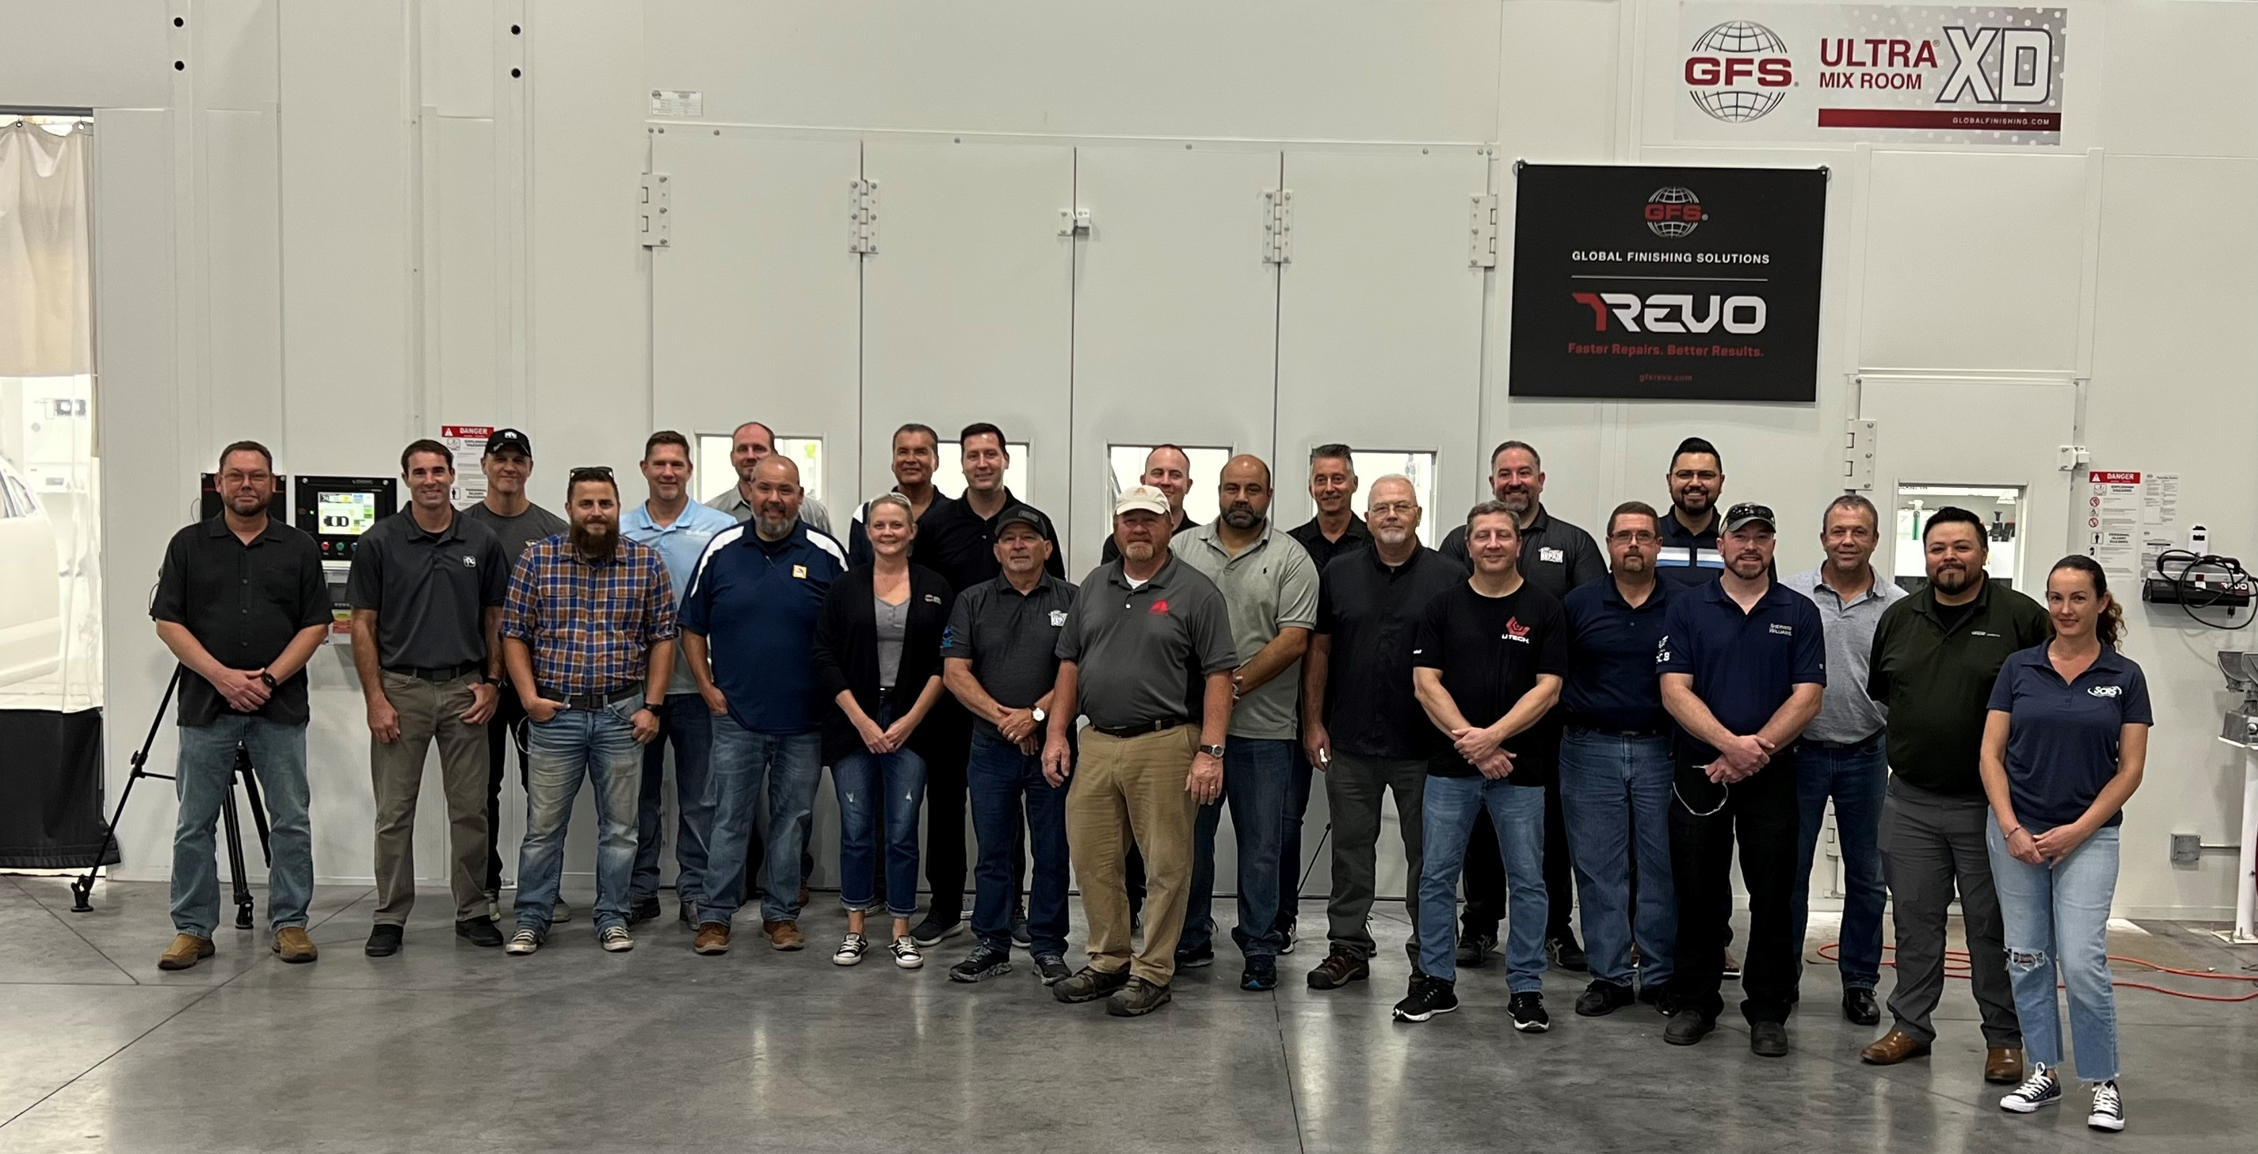

Slide 7
SPECIAL THANKS TO

Slide 8
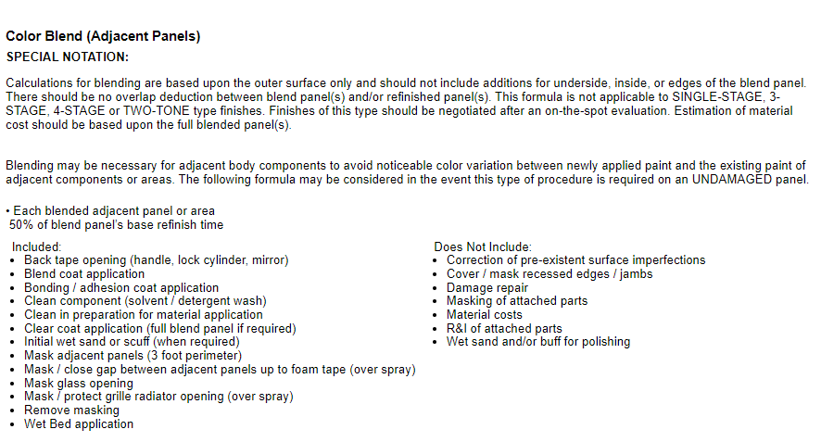
CCC / MOTOR

Slide 9
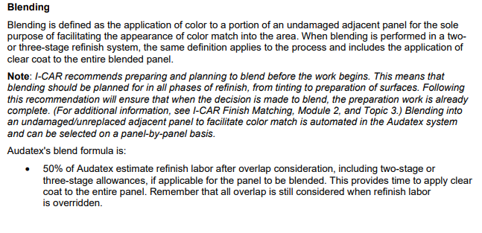
AUDATEX / SOLERA

Slide 10
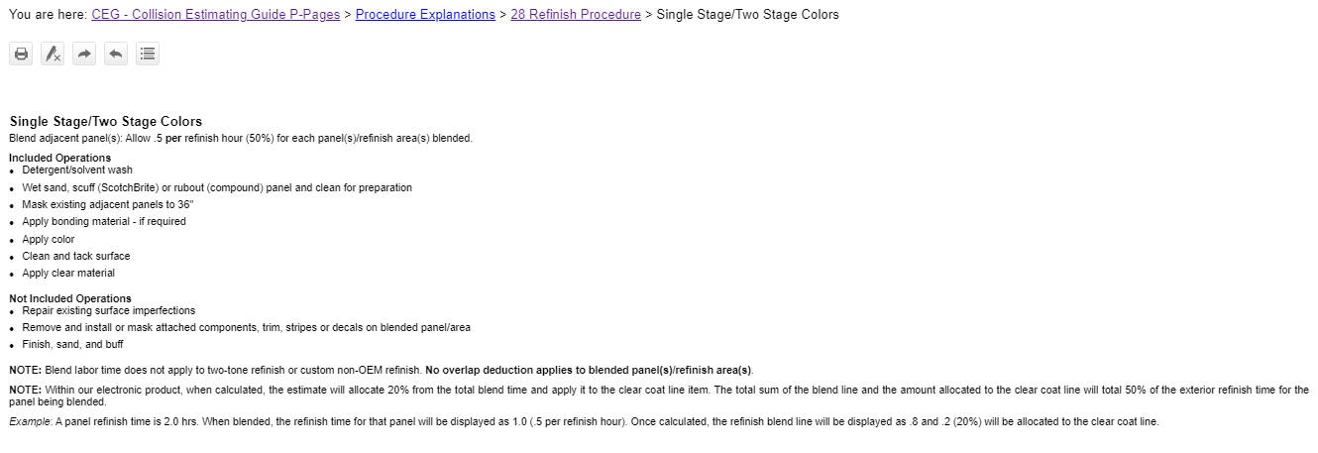
MITCHELL

Slide 11
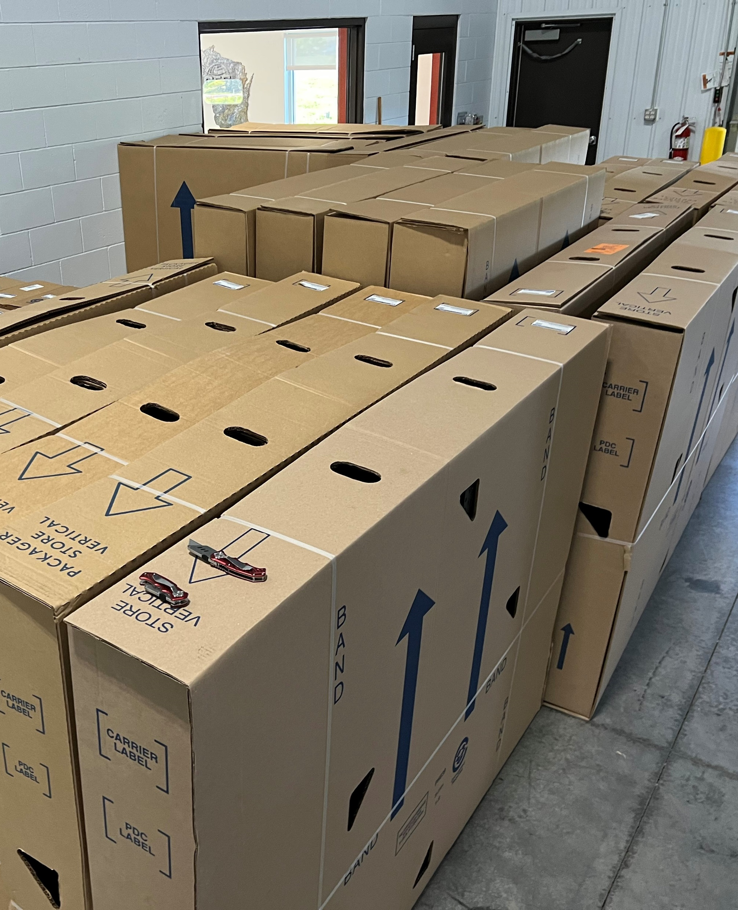
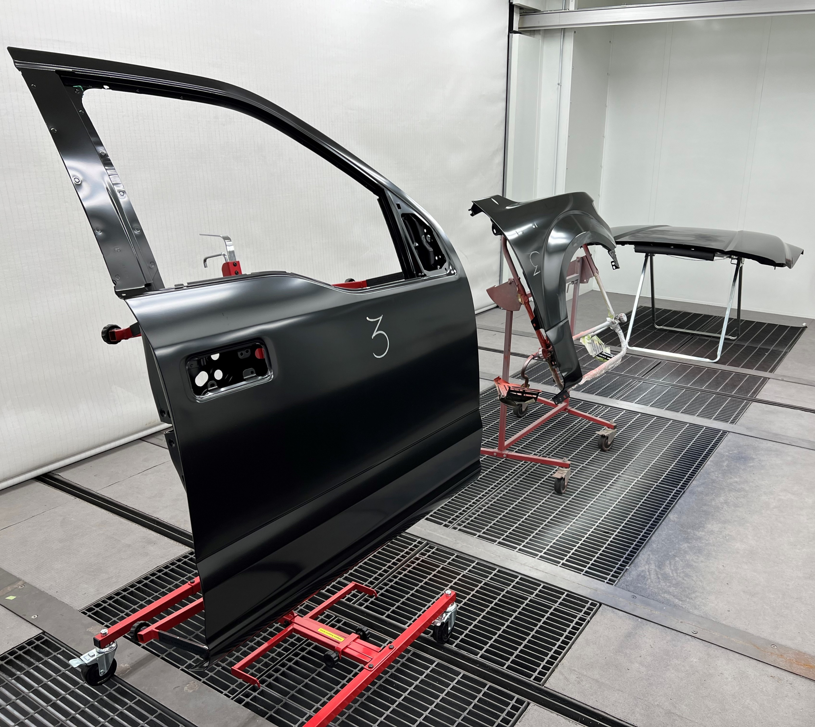

Slide 12
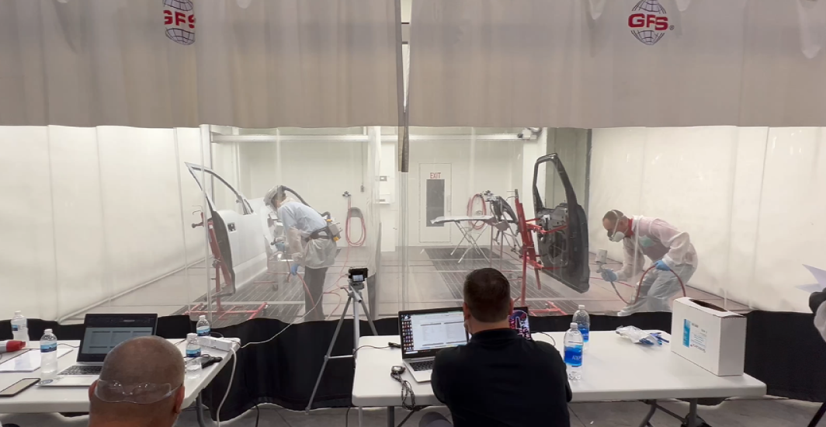
THE BASIS OF THE RESEARCH

Slide 13
CCC - BLEND
50% of Refinish
INCLUDED:
• Back tape opening (handle, lock cylinder, mirror)
• Blend coat application
• Bonding/adhesion coat application
• Clean component (solvent/detergent wash)
• Clean in preparation for material application
• Clear coat application (full blend panel if required)
• Initial wet sand or scuff (when required)
• Mask adjacent panels (three-foot perimeter)
• Mask/close gap between adjacent panels up to foam tape (overspray)
• Mask glass opening
• Mask/protect grille radiator opening (overspray)
• Remove masking
• Wet Bed application

Slide 14
AUDATEX - BLEND
50% of Refinish
INCLUDED:
• Complete preparation of blended panel
• Scuff or buff
• Application of color to blended panel
• Application of clear coat to entire blended panel in two- stage and three-stage systems

Slide 15
MITCHELL - BLEND
50% of Refinish
INCLUDED:
• Detergent/solvent wash
• Wet sand, scuff (ScotchBrite) or rubout
(compound) panel and clean for preparation
• Mask existing adjacent panels to 36"
• Apply bonding material - if required
• Apply color
• Clean and tack surface
• Apply clear material

Slide 16
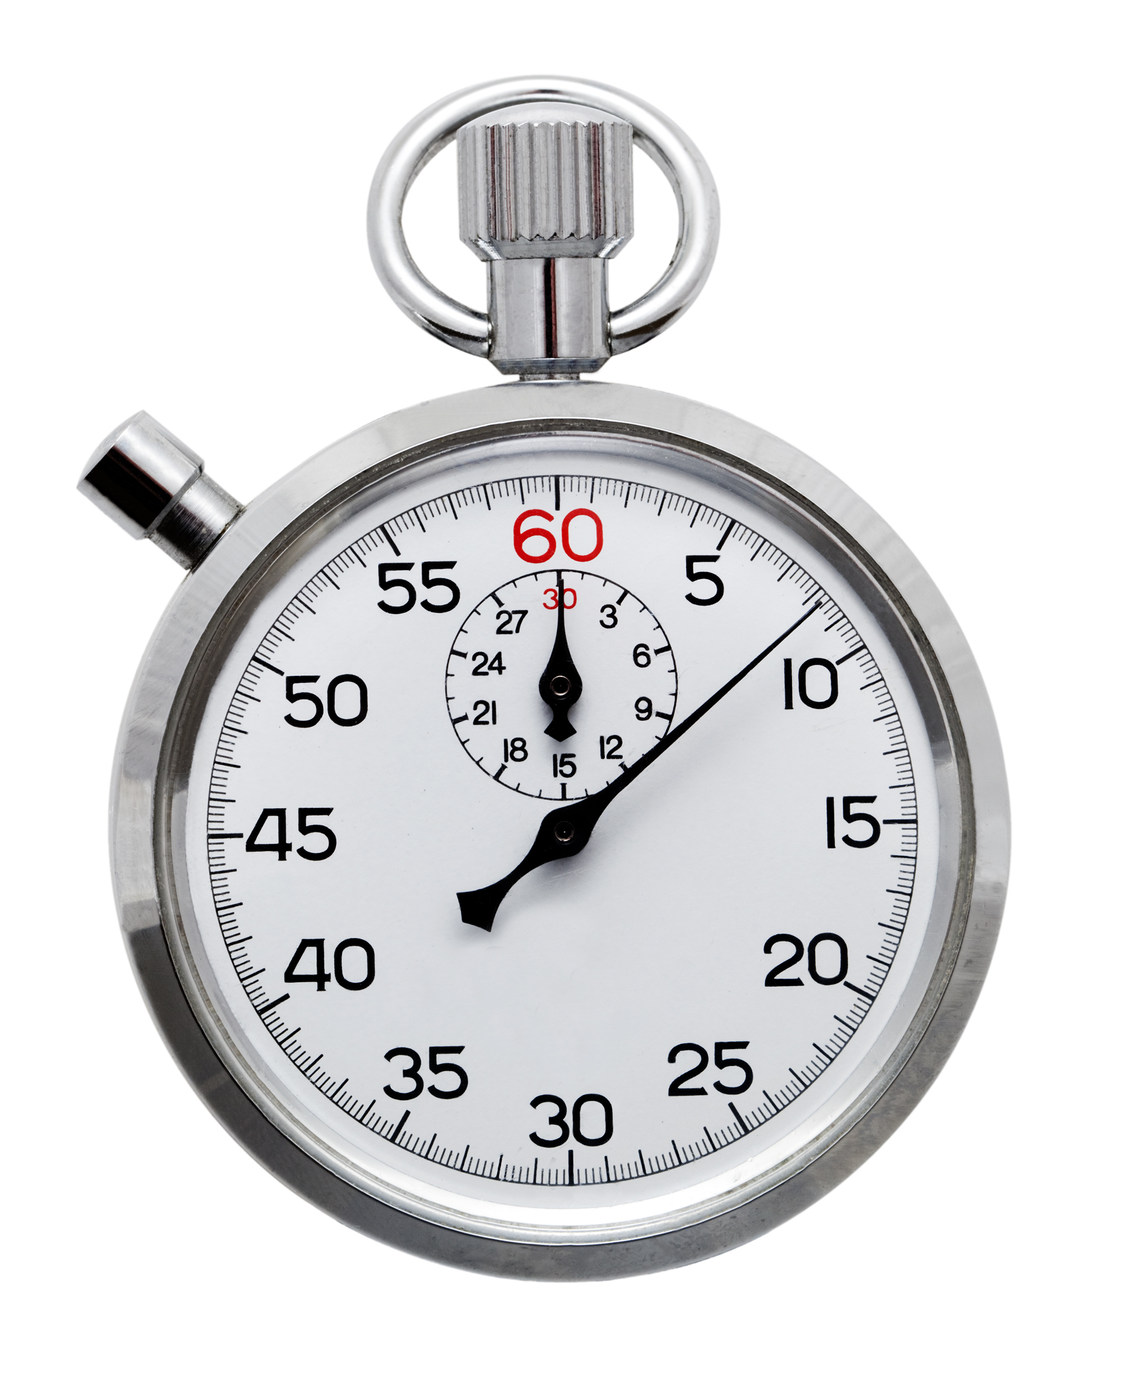
THIS WAS A COMPARATIVE ANALYSIS OF TWO REFINISH OPERATIONS…
…THIS WAS NOT A REFINISH TIME STUDY

Slide 17
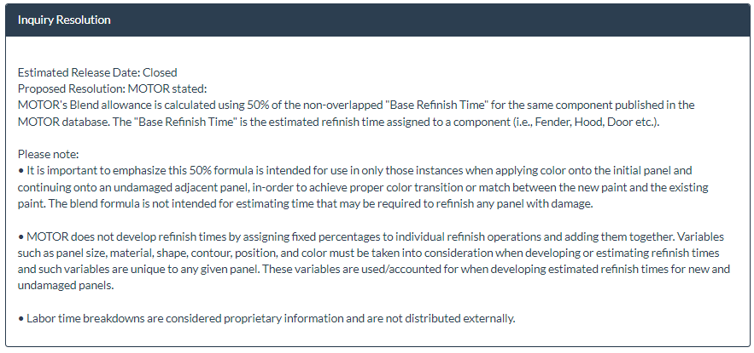
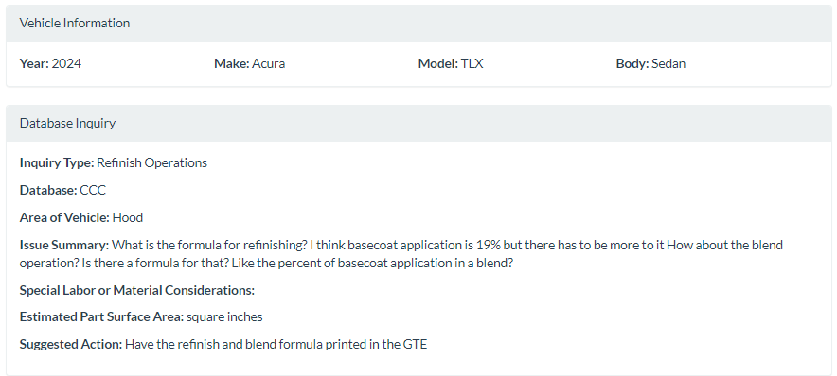
WHY THIS WAS NOT A REFINISH TIME STUDY

Slide 18
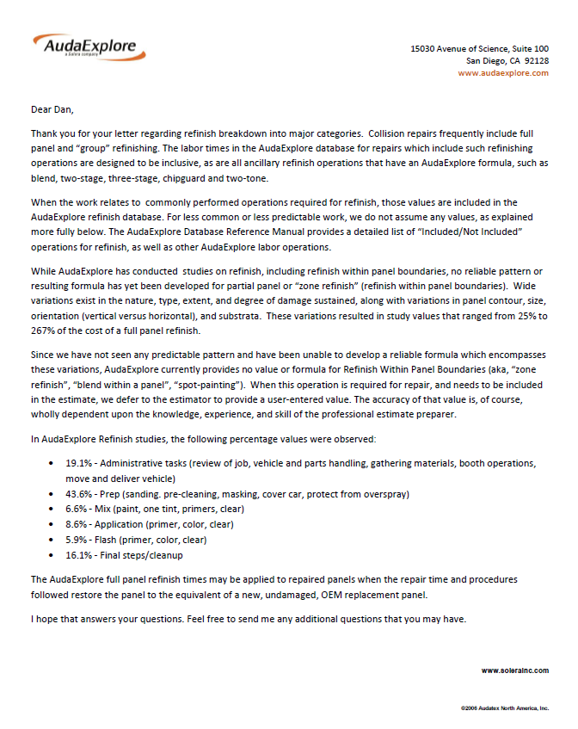
WHY THIS WAS NOT A REFINISH TIME STUDY
19.1% - administrative tasks (review of job, vehicle and parts handling, gathering materials, booth operations, move and deliver vehicle)
43.6% - prep (sanding, pre-cleaning, masking, cover car, protect from overspray)
6.6% - mix (paint, one tint, primers, clear)
8.6% - application (primer, color, clear)
5.9% - flash (primer, color, clear)
16.1% - final steps / cleanup

Slide 19
WHY THIS WAS NOT A REFINISH TIME STUDY
19.1% - administrative tasks (review of job, vehicle and parts handling, gathering materials, booth operations, move and deliver vehicle)
43.6% - prep (sanding, pre-cleaning, masking, cover car, protect from overspray)
6.6% - mix (paint, one tint, primers, clear)
8.6% - application (primer, color, clear)
5.9% - flash (primer, color, clear)
16.1% - final steps / cleanup

Slide 20
WHY THIS WAS NOT A REFINISH TIME STUDY
We did not study the entire process, or the full list of included items
We did not track administrative steps (ex: review of job, vehicle and parts handling, gathering materials, booth operations, move and deliver vehicle)
We did not have a vehicle, so we started with an assumption that color validation had already been completed (collecting color code, color tint, let down cards, validation steps, etc.)

Slide 21
WHAT WE DID DO IN THE COMPARISON
We compared the percentage of time to perform a blend for color match on an adjacent panel to the full refinish to the exterior of a “new and undamaged” OEM part,

Slide 22
WHAT WE DID DO IN THE COMPARISON
Hood, Full Refinish, New Part
Verify Color
Create Spray-out/ Let Down Panel
Mix Basecoat
Clean w/ wax & grease
Sand w/ 600 grade Defect removal
Clean w/ Waterborne pre-cleaner
Blow and tack panels
Mix and reduce Sealer
Apply Sealer
Clean spray gun
Reduce Basecoat
Apply 1st coat of base
Apply 2nd coat of base (Control coat)
Flash Panel
Check for perceived hiding/ Blend
Clean spray gun
Mix Clear Coat
Tack Panel
Apply 1.5 coats of Clear
Clean spray gun
Hood, Blend
Verify Color
Create Spray-out/ Let Down Panel
Mix Basecoat
Clean w/ soap & water
Clean w/ wax & grease
Sand blend panel w/ 1000 grade scuff pad
Sand blend panel w/ 1000 grade DA
Mask for Paint
Clean w/ Waterborne pre-cleaner
Blow and tack panels
Mix / Reduce Wet Bed
Reduce Basecoat
Apply Wet Bed
Apply 1st coat of base
Apply 2nd coat of base (Control coat)
Flash Panel
Check for perceived hiding/ Blend
Clean Blender spray gun
Clean spray gun
Mix Clear Coat
Tack Panel
Apply 1.5 coats of Clear
Clean spray gun
Remove Masking

Slide 23
RESULTS – SOLID – OXFORD WHITE YZ/Z1
The average Blend on the solid white, was
129.61 %
of Full Refinish

Slide 24
RESULTS – METALLIC – INGOT SILVER METALLIC, UX
The average Blend on the metallic silver, was
142.69 %
of Full Refinish

Slide 25
RESULTS – 3-STAGE – WHITE PLATINUM TRI-COAT, UG
The average Blend on the white tri-coat, was
124.60 %
of Full Refinish

Slide 26
RESULTS – OVERALL AVERAGE
When averaged overall, Blending was
131.59 %
of Full Refinish
6%

Slide 27
CONCLUSIONS + IMPLICATIONS

Slide 28
CONCLUSIONS + IMPLICATIONS

Slide 29
CONCLUSIONS + IMPLICATIONS

Slide 30
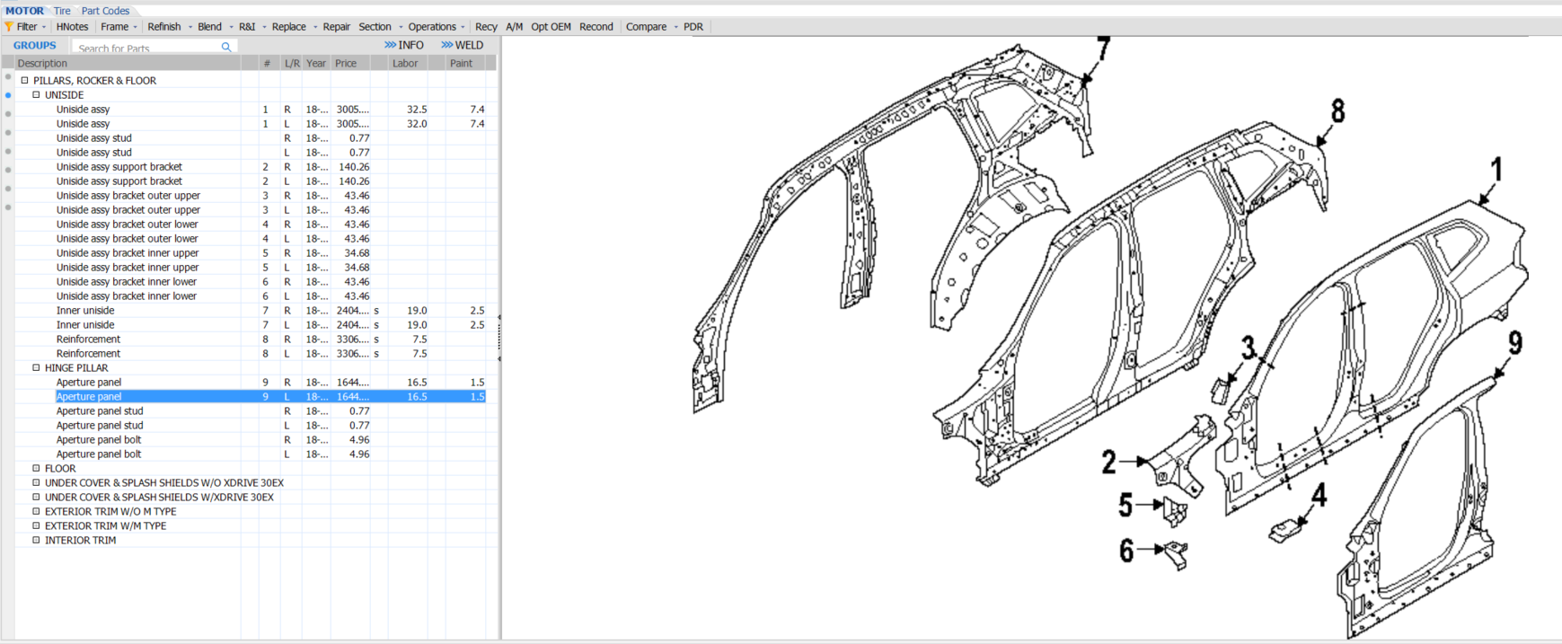
CONCLUSIONS + IMPLICATIONS

Slide 31
CONCLUSIONS + CONVERSATIONS

Slide 32
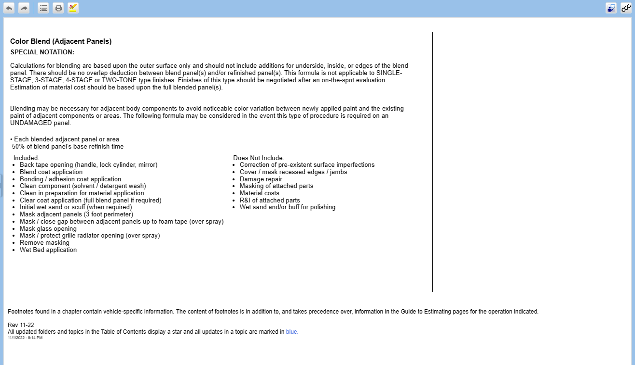
CONCLUSIONS + CONVERSATIONS

Slide 33
CONCLUSIONS + CONVERSATIONS

Slide 34
CONCLUSIONS + CONVERSATIONS
“Given the variations among scenarios today, MOTOR believes that the estimated Work Time Development methodology should defer to the judgement of an estimator or appraiser following an on-the-spot evaluation of the specific vehicle and refinish requirements in question.”

Slide 35
CONCLUSIONS + CONVERSATIONS
The change is designed to account for variations in modern vehicle paint refinishing and will be made in October 2023 as part of the company’s
standard GTE update schedule.

Slide 37
“If it’s two-stage today, it just takes 50% of the refinished time and adds it to the estimate”
“If it’s three-stage, it takes 70% and adds it to the estimate, which is MOTOR guidance today. With this updated guidance that MOTOR will be making, we’re going to enhance or change that functionality to support that.”

Slide 38
CONCLUSIONS + CONVERSATIONS
“Now that MOTOR’s guidance does require an on-the-spot evaluation, users will have the option to be prompted, so they can input that blend time on a per-repairer basis based on the amount of work that needs to be done there. And secondly, we will allow users to input a default value for both two-stage and three-stage to be able to put in a default for their primary profile. Whether it’s a shop or an insurer, they can put in a default for that.”

Slide 39
“We do support MOTOR’s decision.”
“We think this is a good outcome for the industry as a whole and accurately reflects the variation in the process as MOTOR described in the release.”

Slide 40
CONCLUSIONS + CONVERSATIONS

Slide 41
CONCLUSIONS + CONVERSATIONS
“A user can adjust the time in our Solera Qapter estimating solution when there is a need to adjust the automated blend hours. The slide out provides the full refinish time and the blend time so the user is aware of the full panel refinish times as they consider any adjustments for blend labor time.”

Slide 42
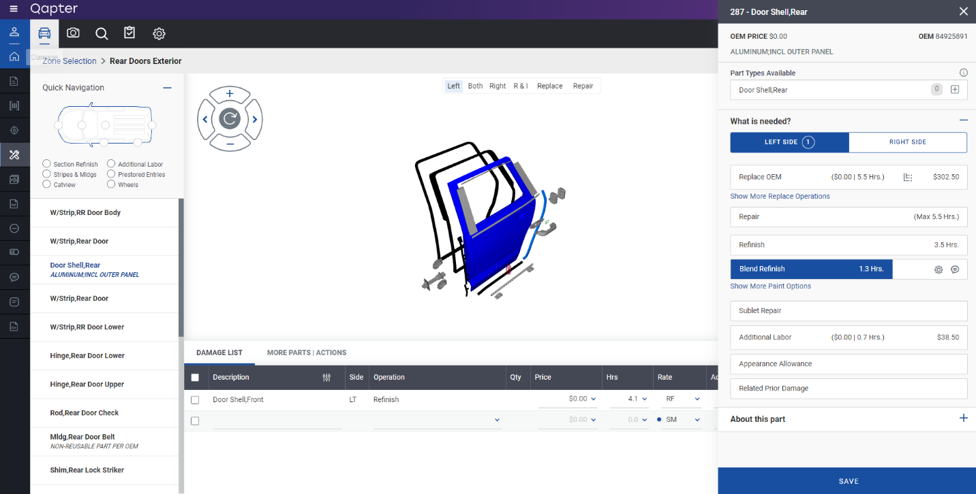
CONCLUSIONS + CONVERSATIONS
Select the appropriate part (the slide out will appear)
Select Blend Refinish
Select the gear icon in the Blend Refinish bar

Slide 43
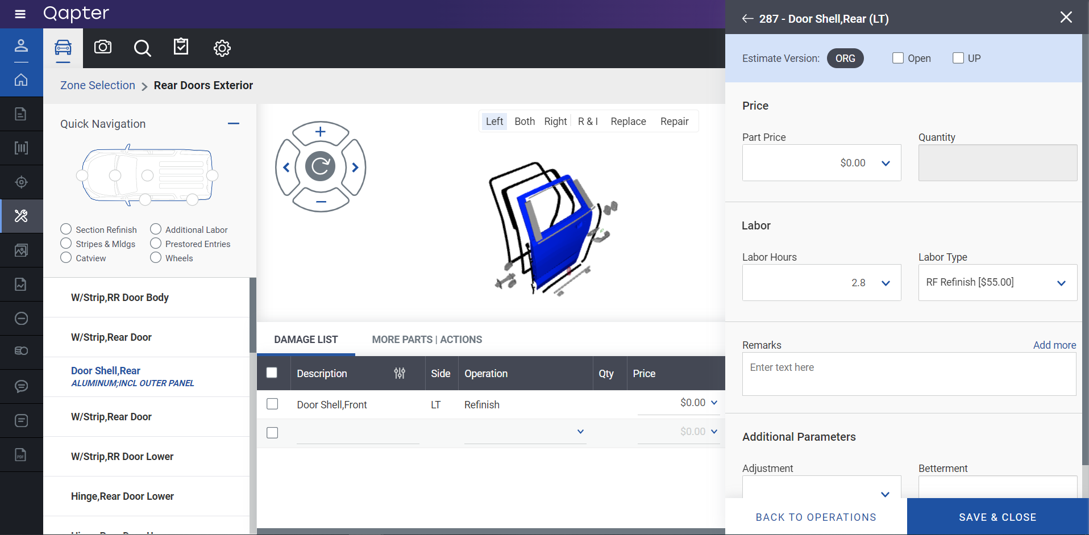
CONCLUSIONS + CONVERSATIONS
4. Enter the user defined time in the Labor Hours box
5. Select Save & Close

Slide 44
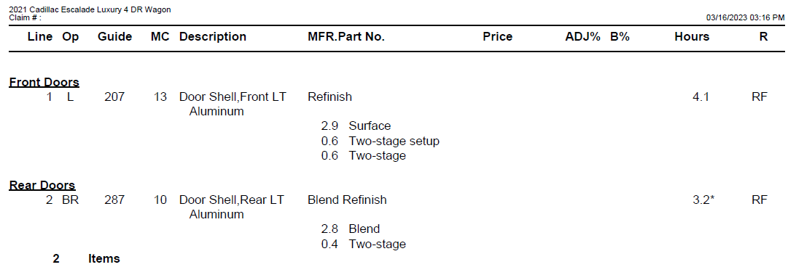
CONCLUSIONS + CONVERSATIONS

Slide 45
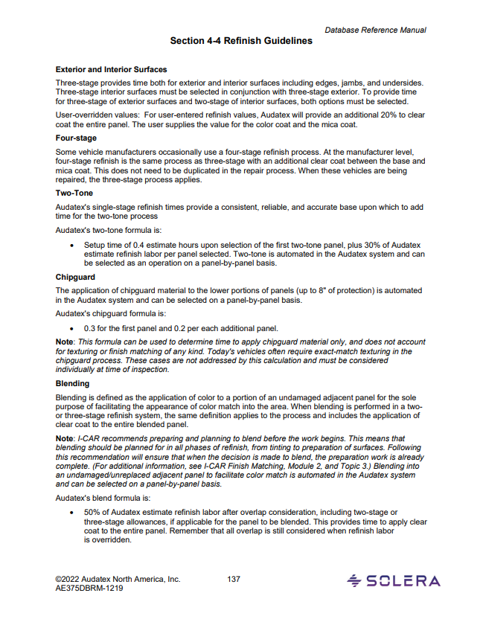

Slide 46
What it will say:
Blending
Blending is defined as the application of color to a portion of an undamaged adjacent panel for the sole purpose of facilitating the appearance of color match into the area. When blending is performed in a two- or three-stage refinish system, the same definition applies to the process and includes the application of clear coat to the entire blended panel.

Slide 47
What it will say:
Note: I-CAR recommends preparing and planning to blend before the work begins. This means that blending should be planned for in all phases of refinish, from tinting to preparation of surfaces. Following this recommendation will ensure that when the decision is made to blend, the preparation work is already complete. (For additional information, see I-CAR Finish Matching, Module 2, and Topic 3.) Blending into an undamaged/unreplaced adjacent panel to facilitate color match is automated in the Audatex system and can be selected on a panel-by-panel basis.

Slide 48
What it will say:
Audatex refinish labor is based on the use of new and undamaged panels. Audatex Estimating does not provide a standard labor allowance for blended panels as this requires the estimate preparer’s judgment, expertise, and consideration of the unique requirements for each repair. Determination and assessment of labor and materials necessary in the blending process is best provided by the estimate preparer during the estimate preparation process. To assist the user, profile settings allow for customization to enter a specified blend percentage, as necessary.

Slide 49
What it will say:
Audatex will now allow you to specify the Blend Refinish percentage to be used when calculating Blend Refinish labor at the profile level allowing an Insurers and shops to agree on a default blend refinish time. You may enter a value between 50% and 150%. This value is used to determine the blend refinish labor by multiplying it against the full panel refinish time.
When generating an estimate, the blend refinish will be calculated using the value specified at the profile level. If no value is specified, a default value of 50% blend refinish percentage will be used.

Slide 50
What it will say:
As before, an estimator can manually override the Blend Refinish percentage specified at the profile level and it will be denoted with an asterisk (*) on the estimate.
Additionally, a new note is now added to the bottom of all estimates showing the Blend Refinish percentage used.

Slide 51
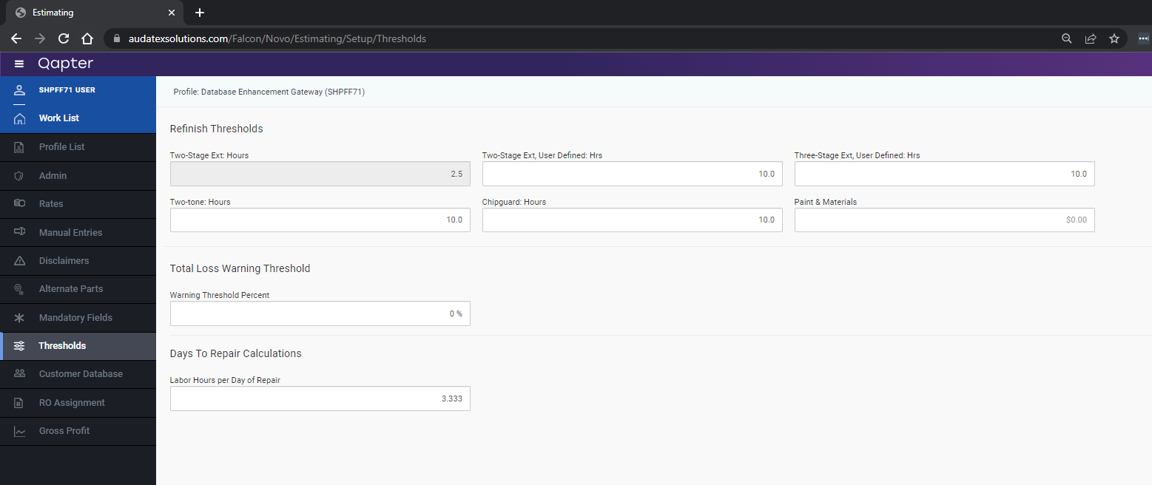
CONCLUSIONS + CONVERSATIONS

Slide 52
CONCLUSIONS + CONVERSATIONS

Slide 54
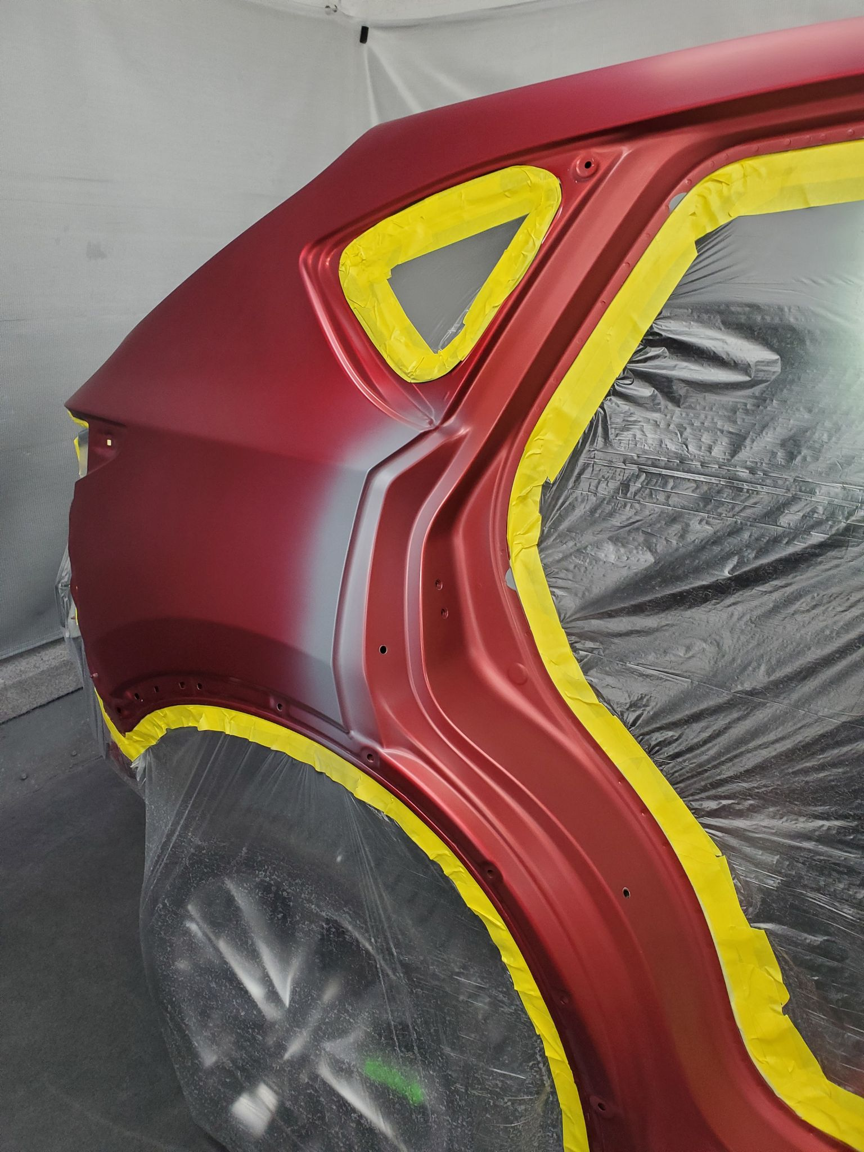

Slide 55
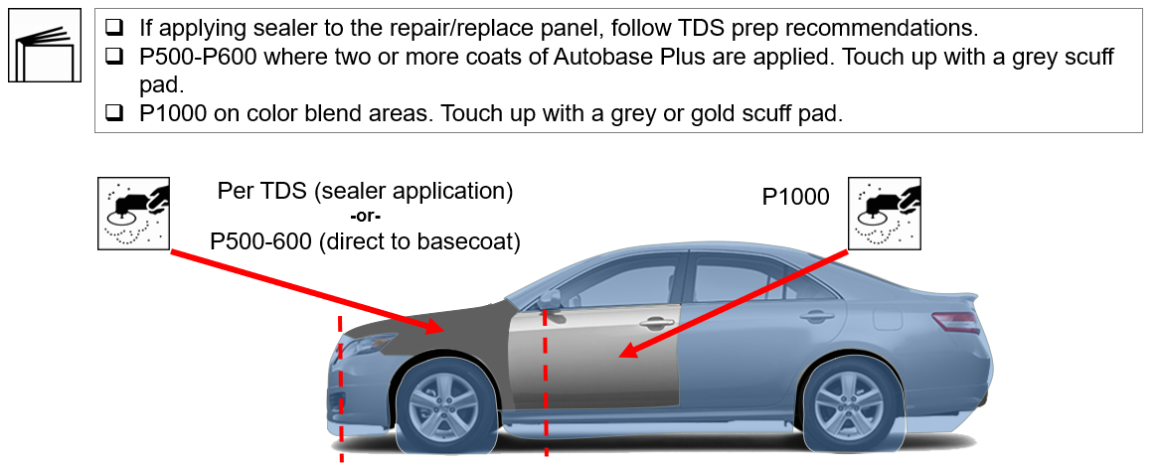

Slide 56
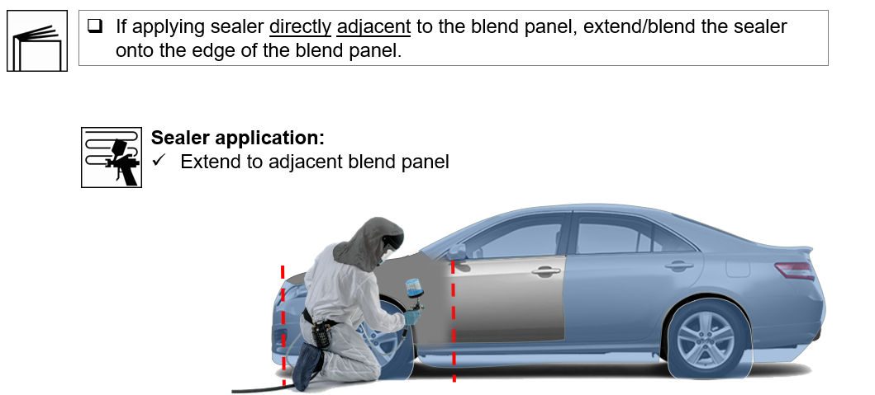

Slide 59
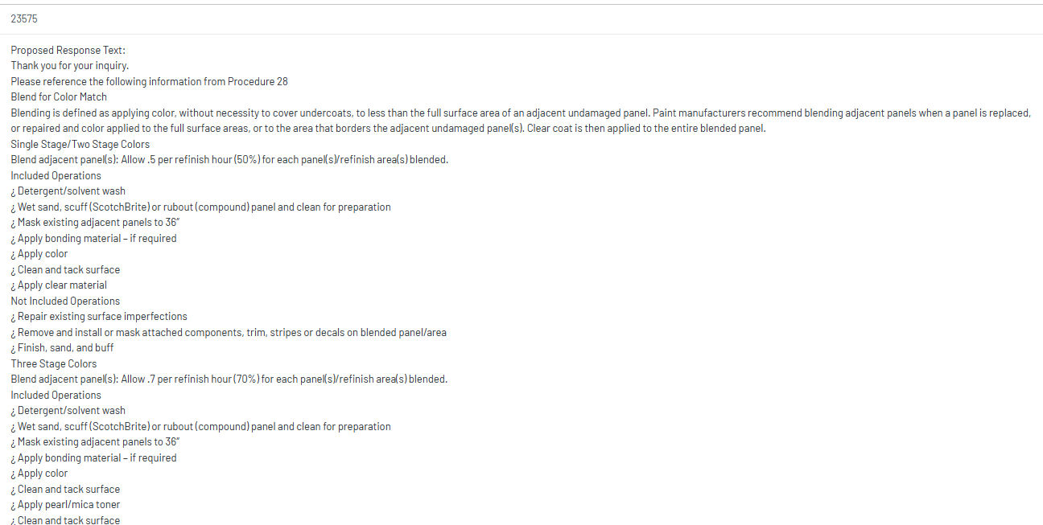

Slide 60
CONCLUSIONS + CONVERSATIONS

Slide 61
CONCLUSIONS + CONVERSATIONS
[No material has been provided by Mitchell at the time of presentation]

Slide 62
QUESTIONS AND DISCUSSION?

Slide 63
UPCOMING MEETING: November
Exploring the purpose and challenges of core programs

